Slide 1
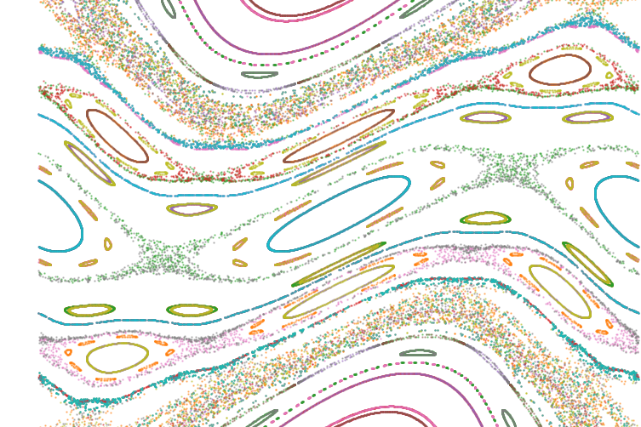
Using Meiss’s action principle to quantify stochasticity in the stellarator edge
Ecole Polytechnique Fédérale de Lausanne
June 2024
Ludovic Rais

Slide 2
Heat exhaust in stellarators
Resonant divertor concept
Non-resonant divertor

Slide 3
Link between the Stochasticity and NRD

Slide 4
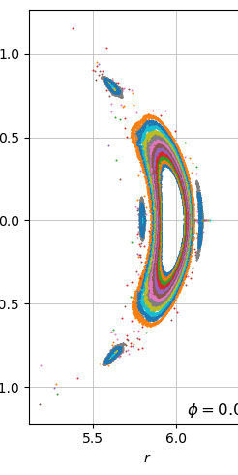
W7X
Cross section
A 5/5 island chain
Gym00 configuration and the 4/5
Show the stochasticity in the edge

Slide 5
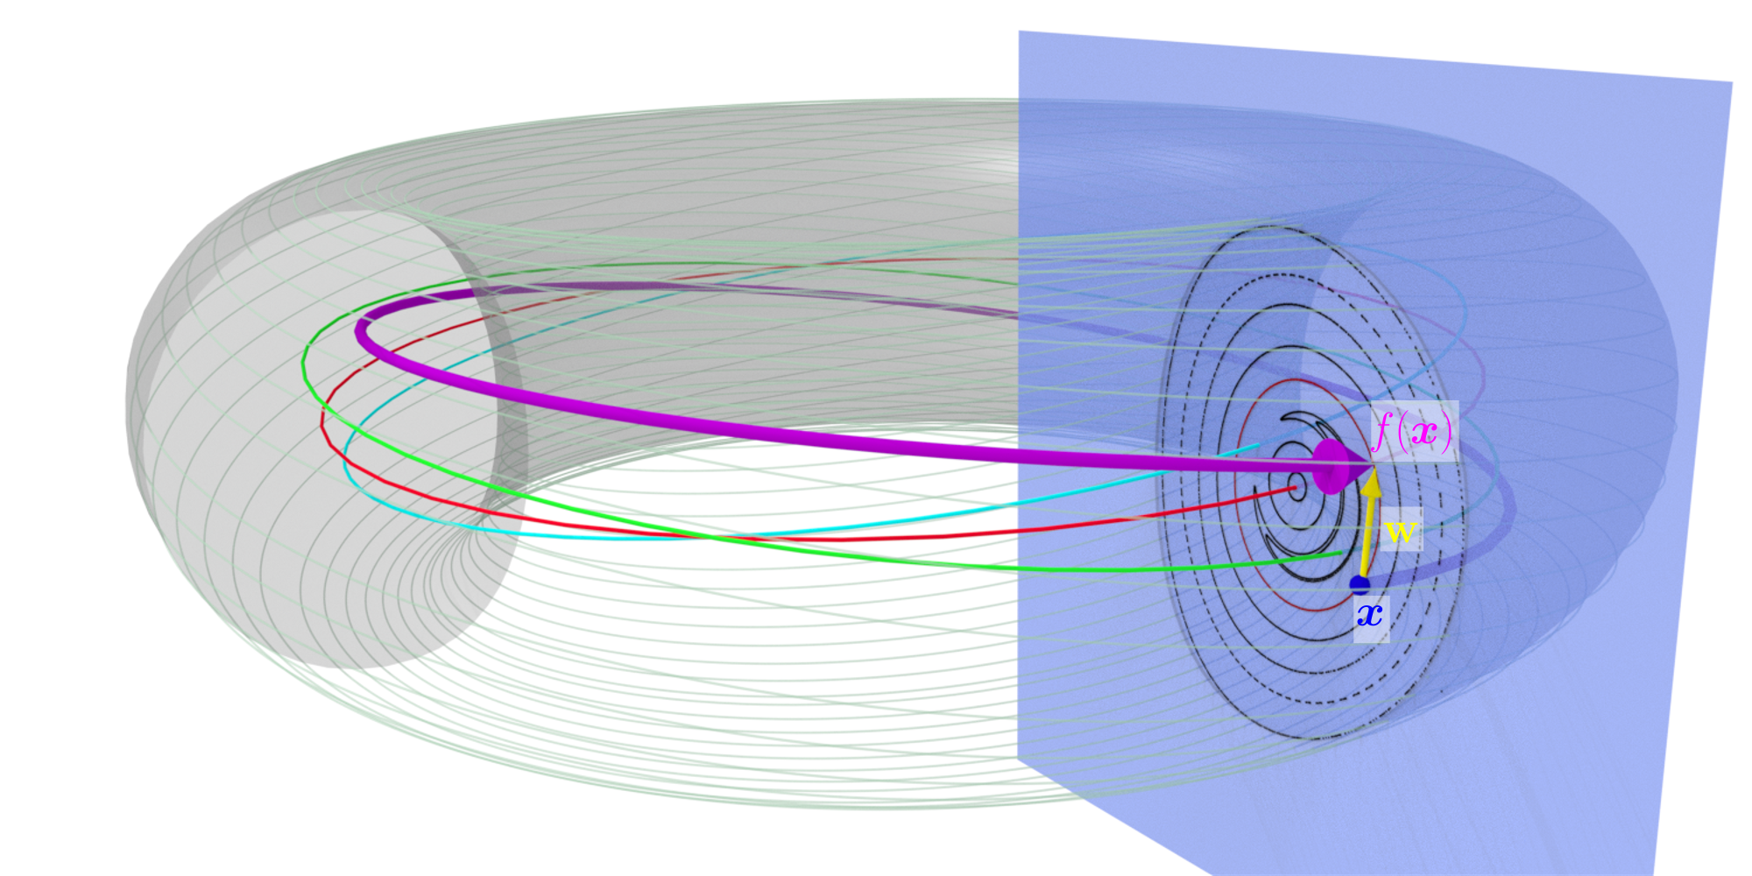
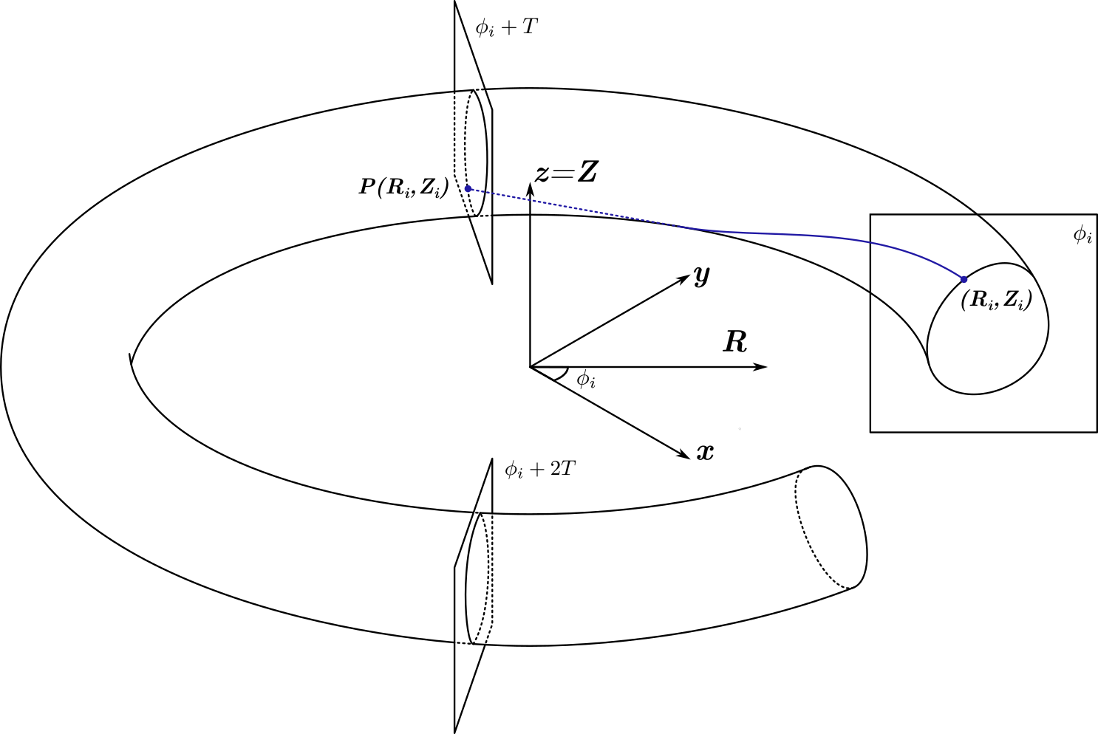
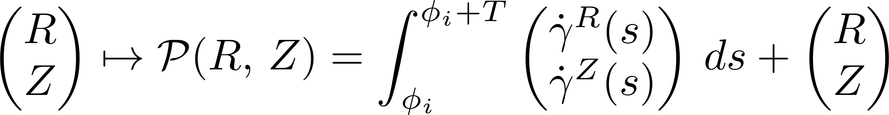
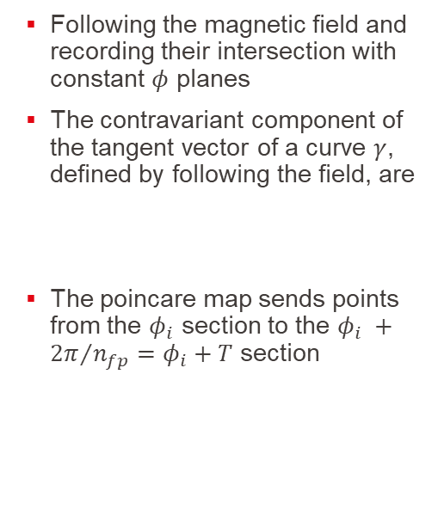
Definition of the Poincare map
Following the magnetic field and recording their intersection with constant $φ$ planes
The contravariant component of the tangent vector of a curve $γ$, defined by following the field, are
The poincare map sends points from the $φ_{i}$ section to the $φ_{i} +{2π}/{n_{fp}=φ_{i}+T}$ section

Slide 6
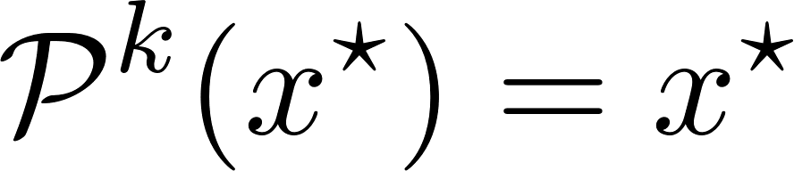
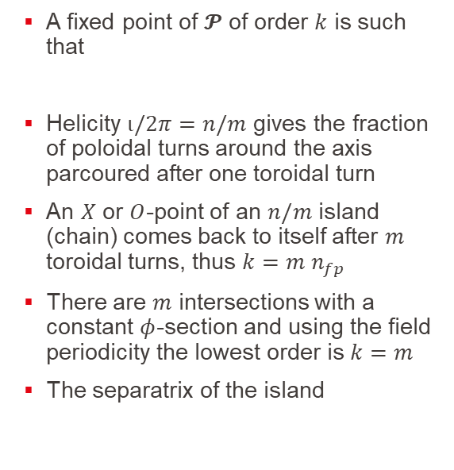
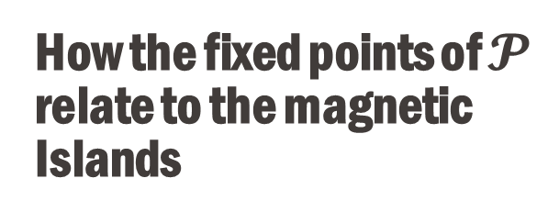
How the fixed points of $𝓟$ relate to the magnetic Islands
A fixed point of $𝓟$ of order $k$ is such that
Helicity $ι/2π=n/m$ gives the fraction of poloidal turns around the axis parcoured after one toroidal turn
An $X$ or $O$-point of an $n/m$ island (chain) comes back to itself after $m$ toroidal turns, thus $k=m n_{fp}$
There are $m$ intersections with a constant $φ$-section and using the field periodicity the lowest order is $k=m$
The separatrix of the island

Slide 7
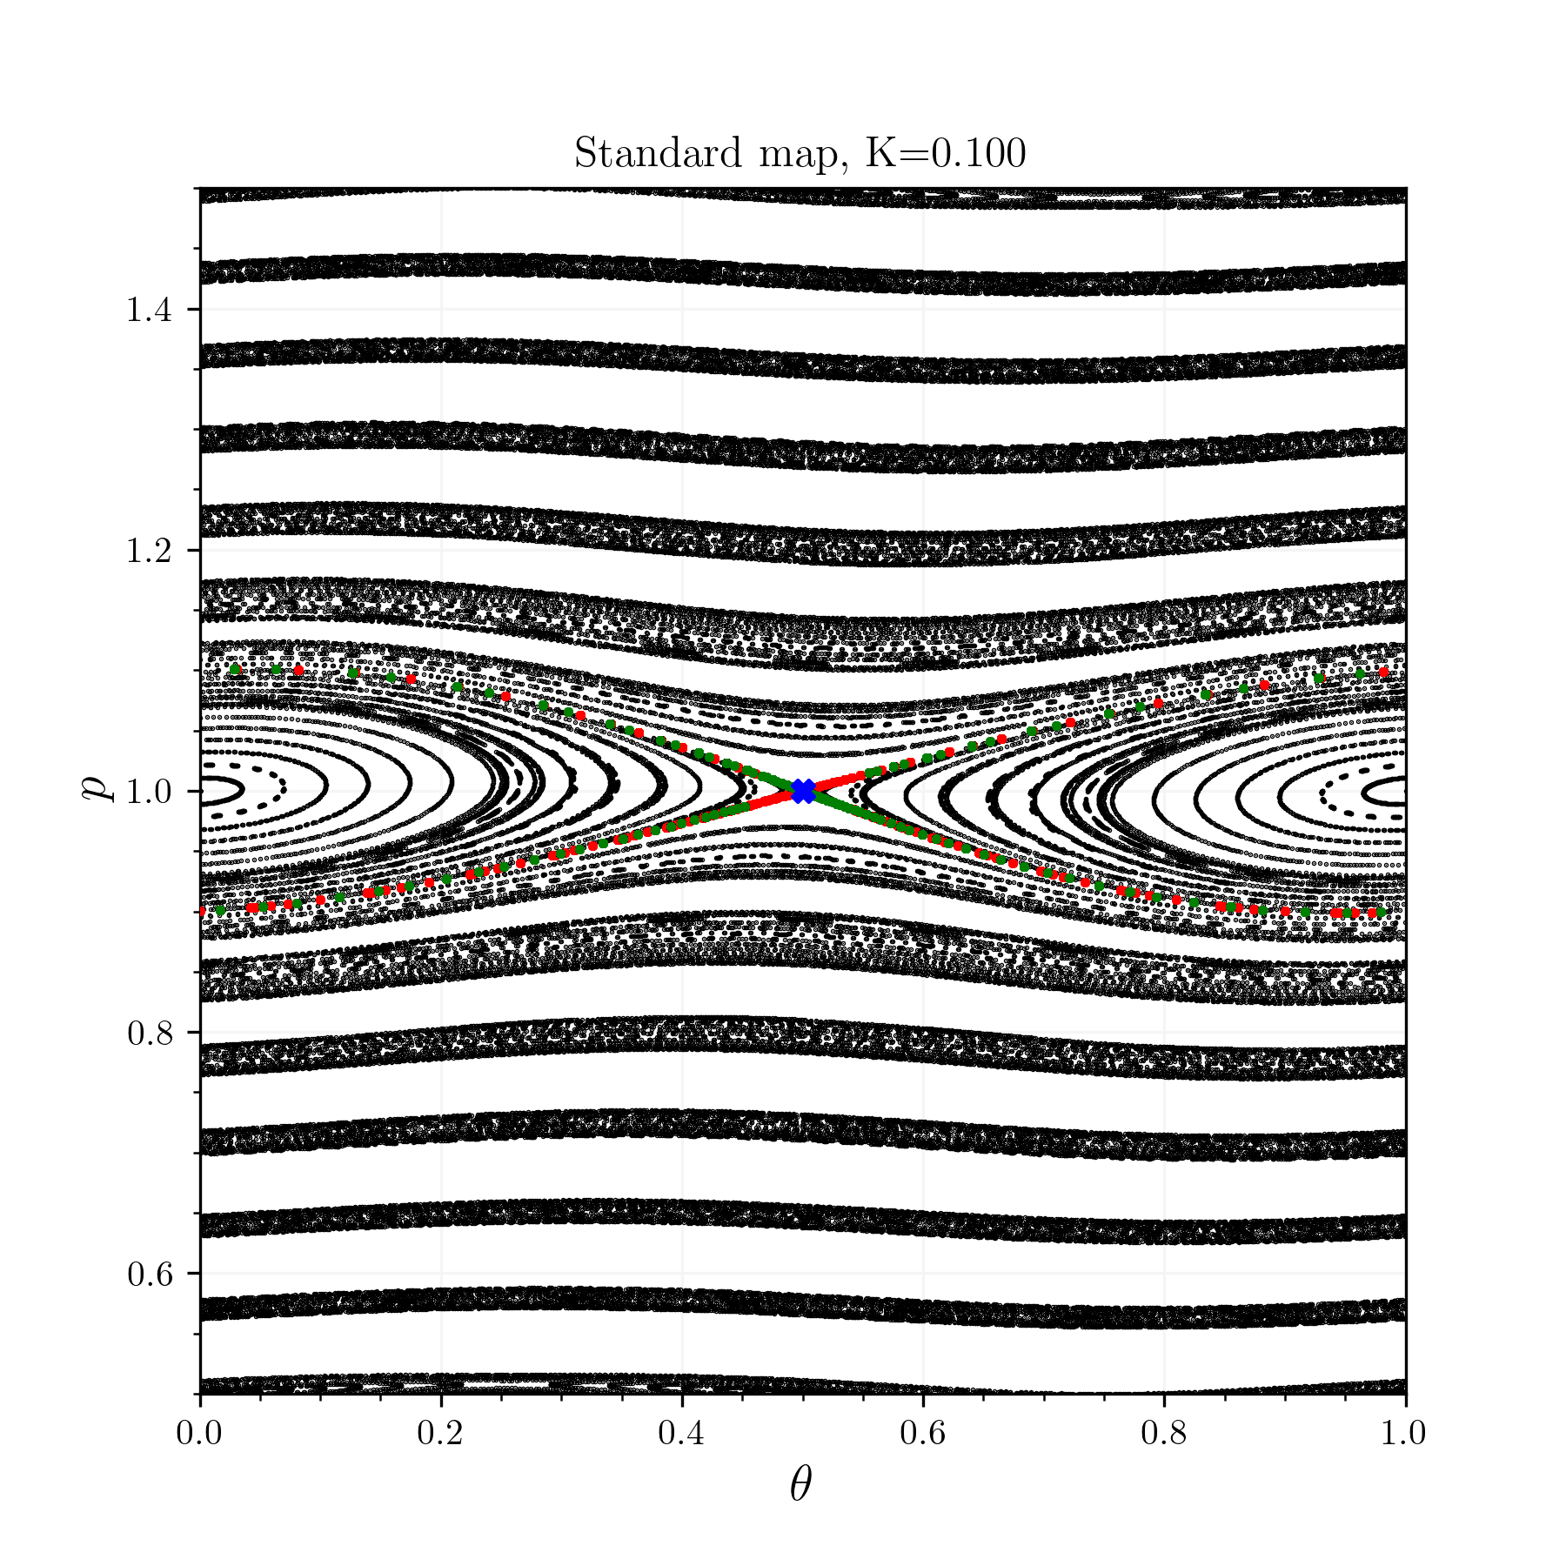
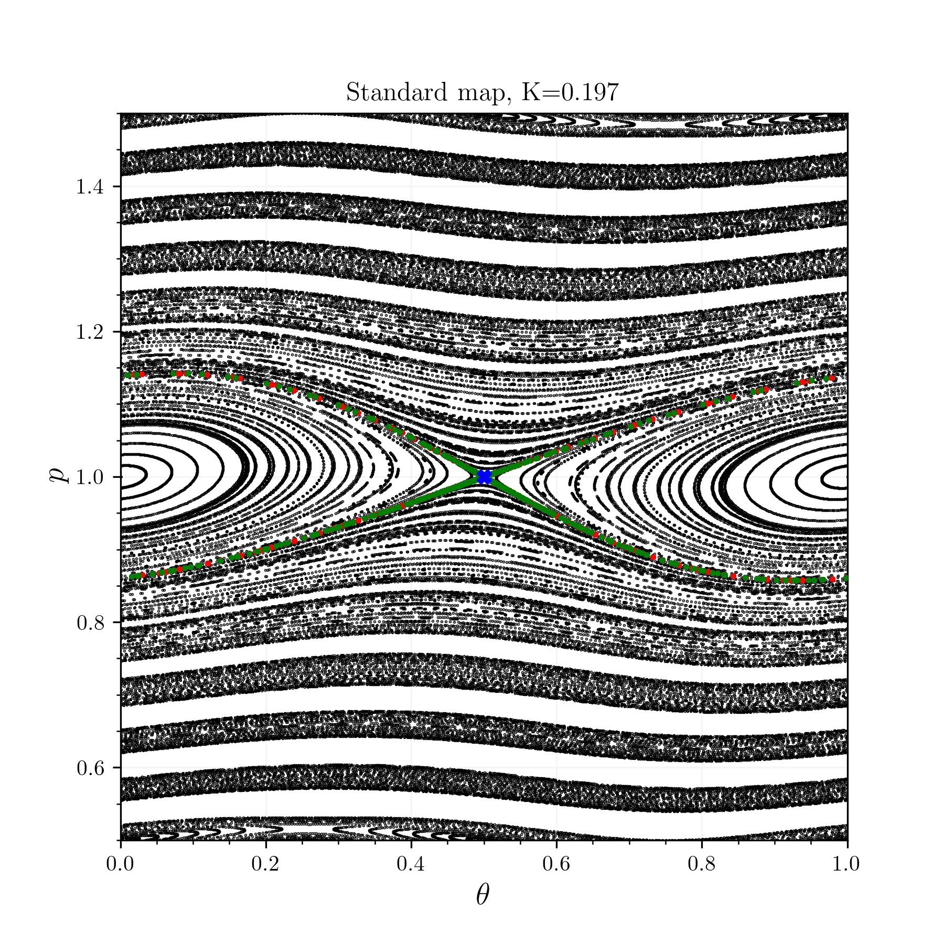
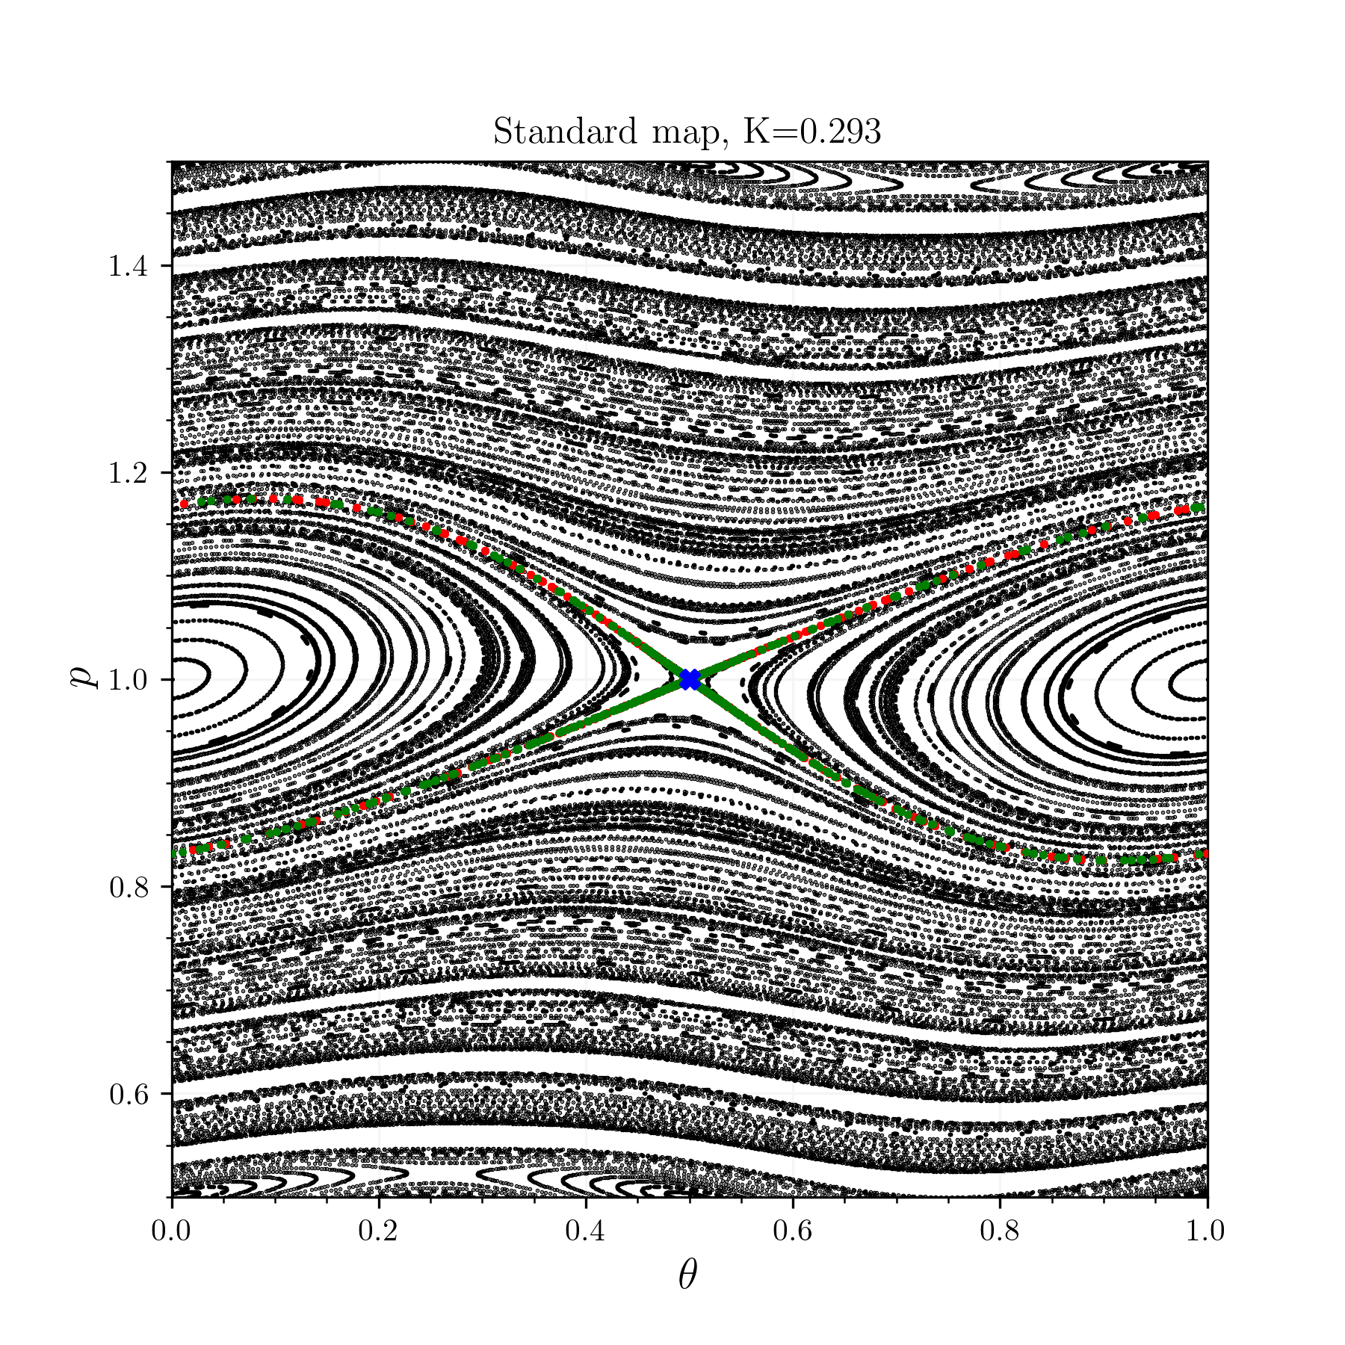
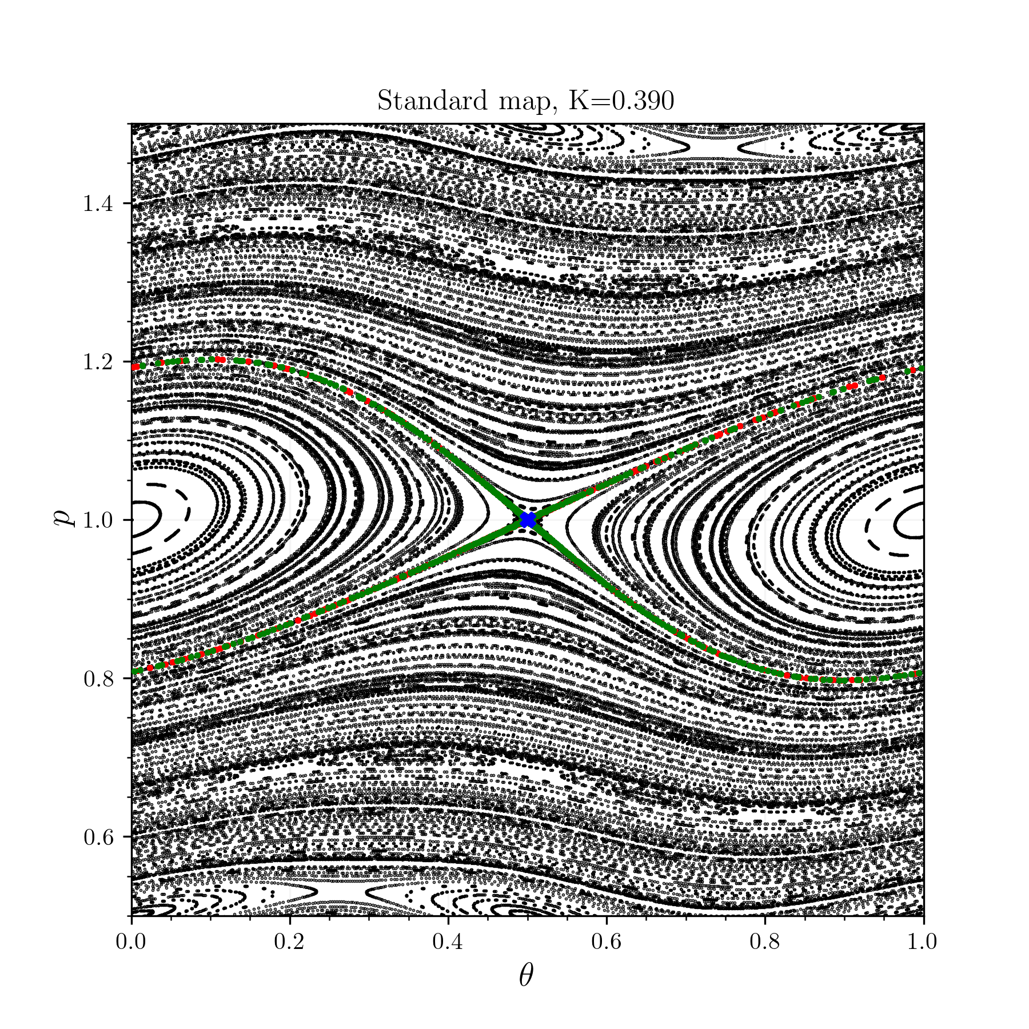
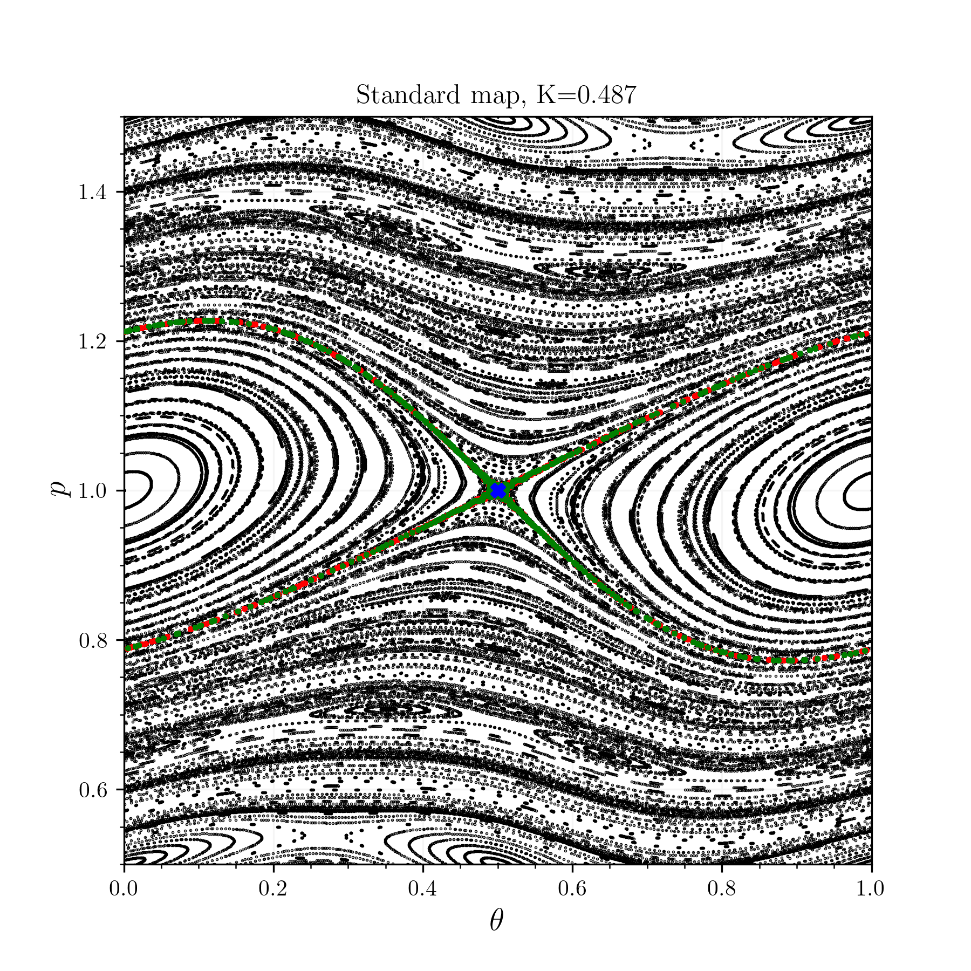
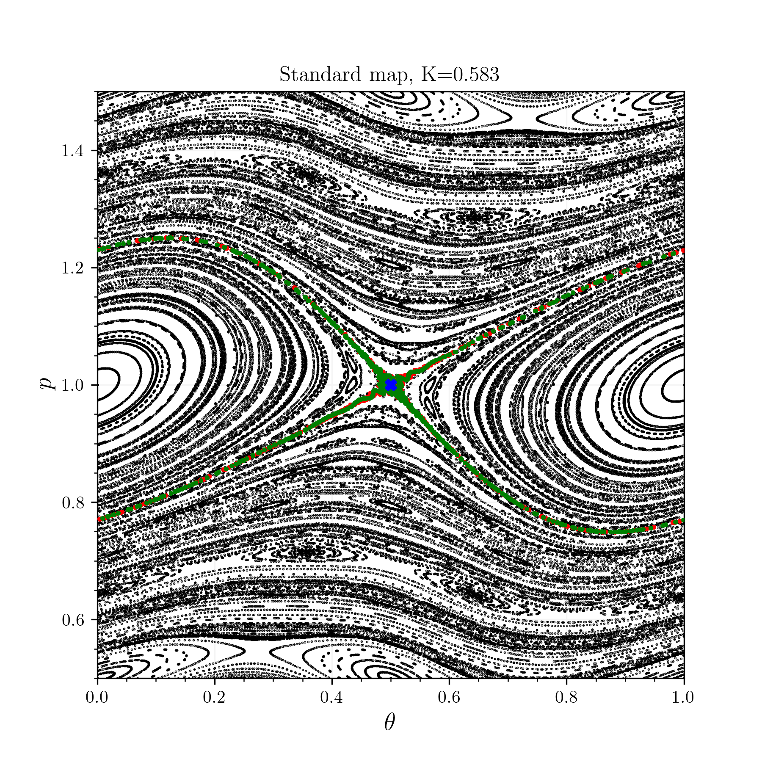
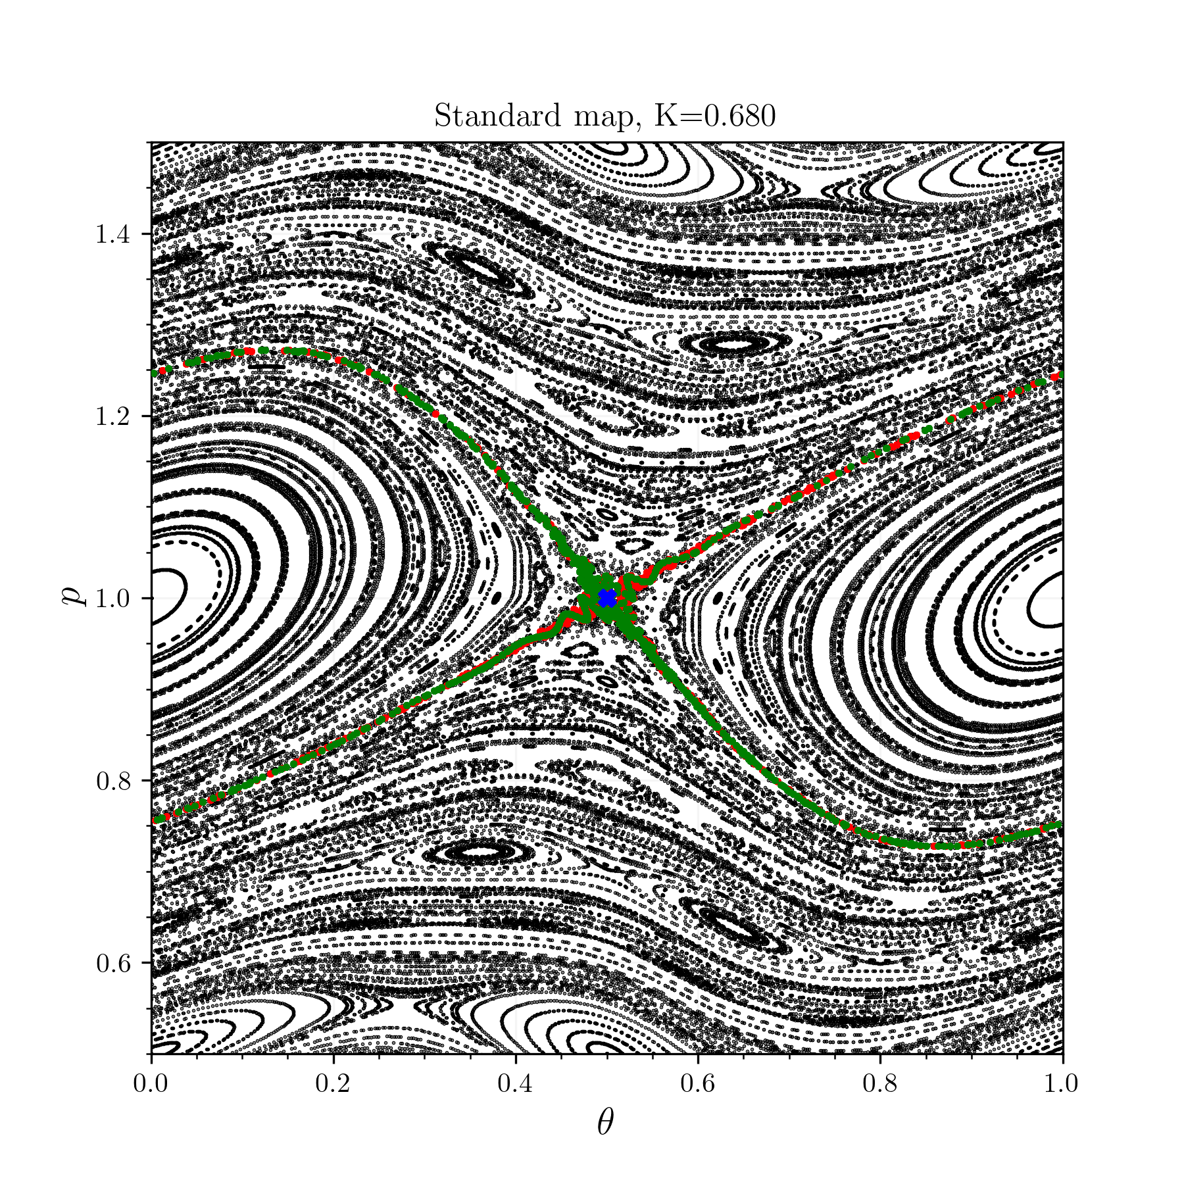
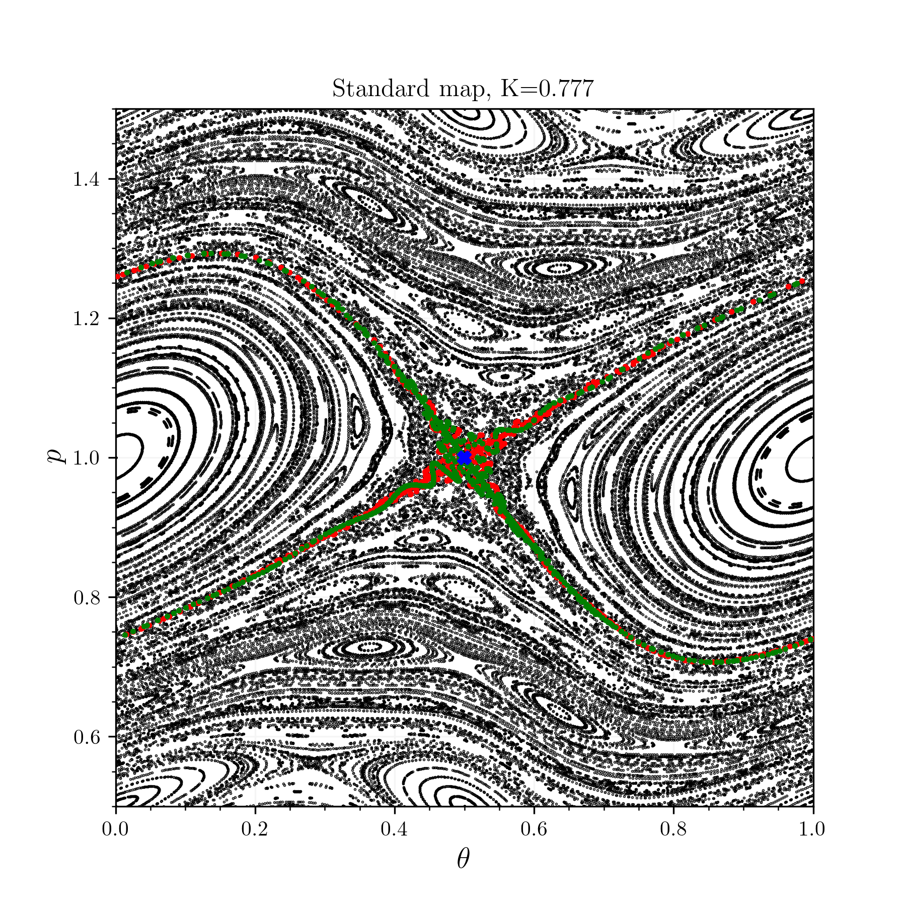
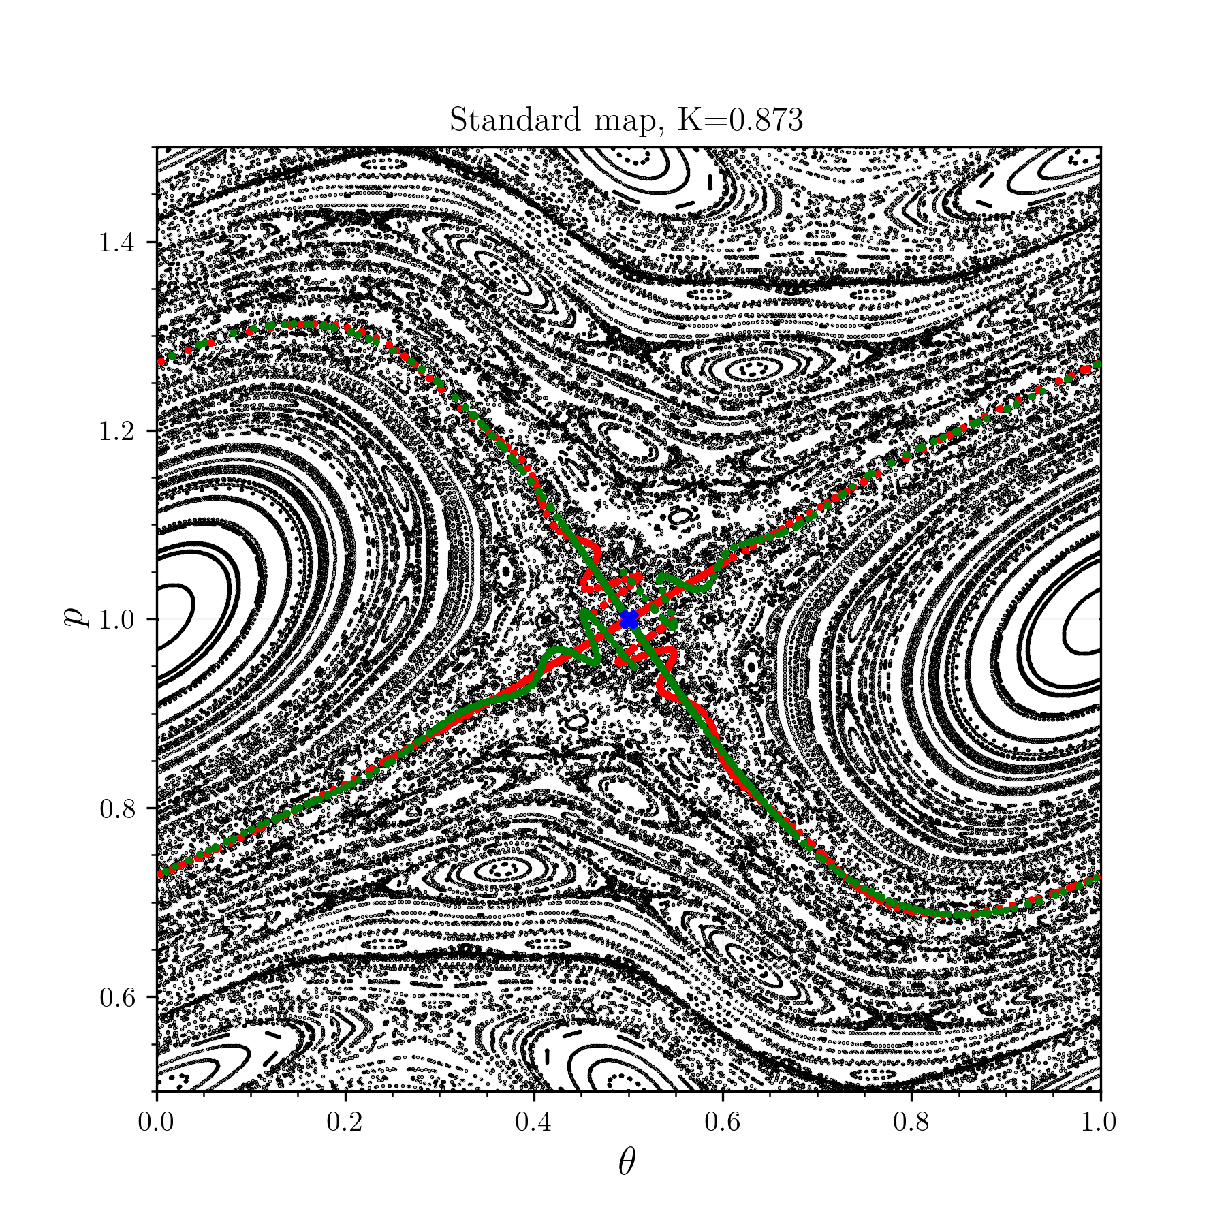
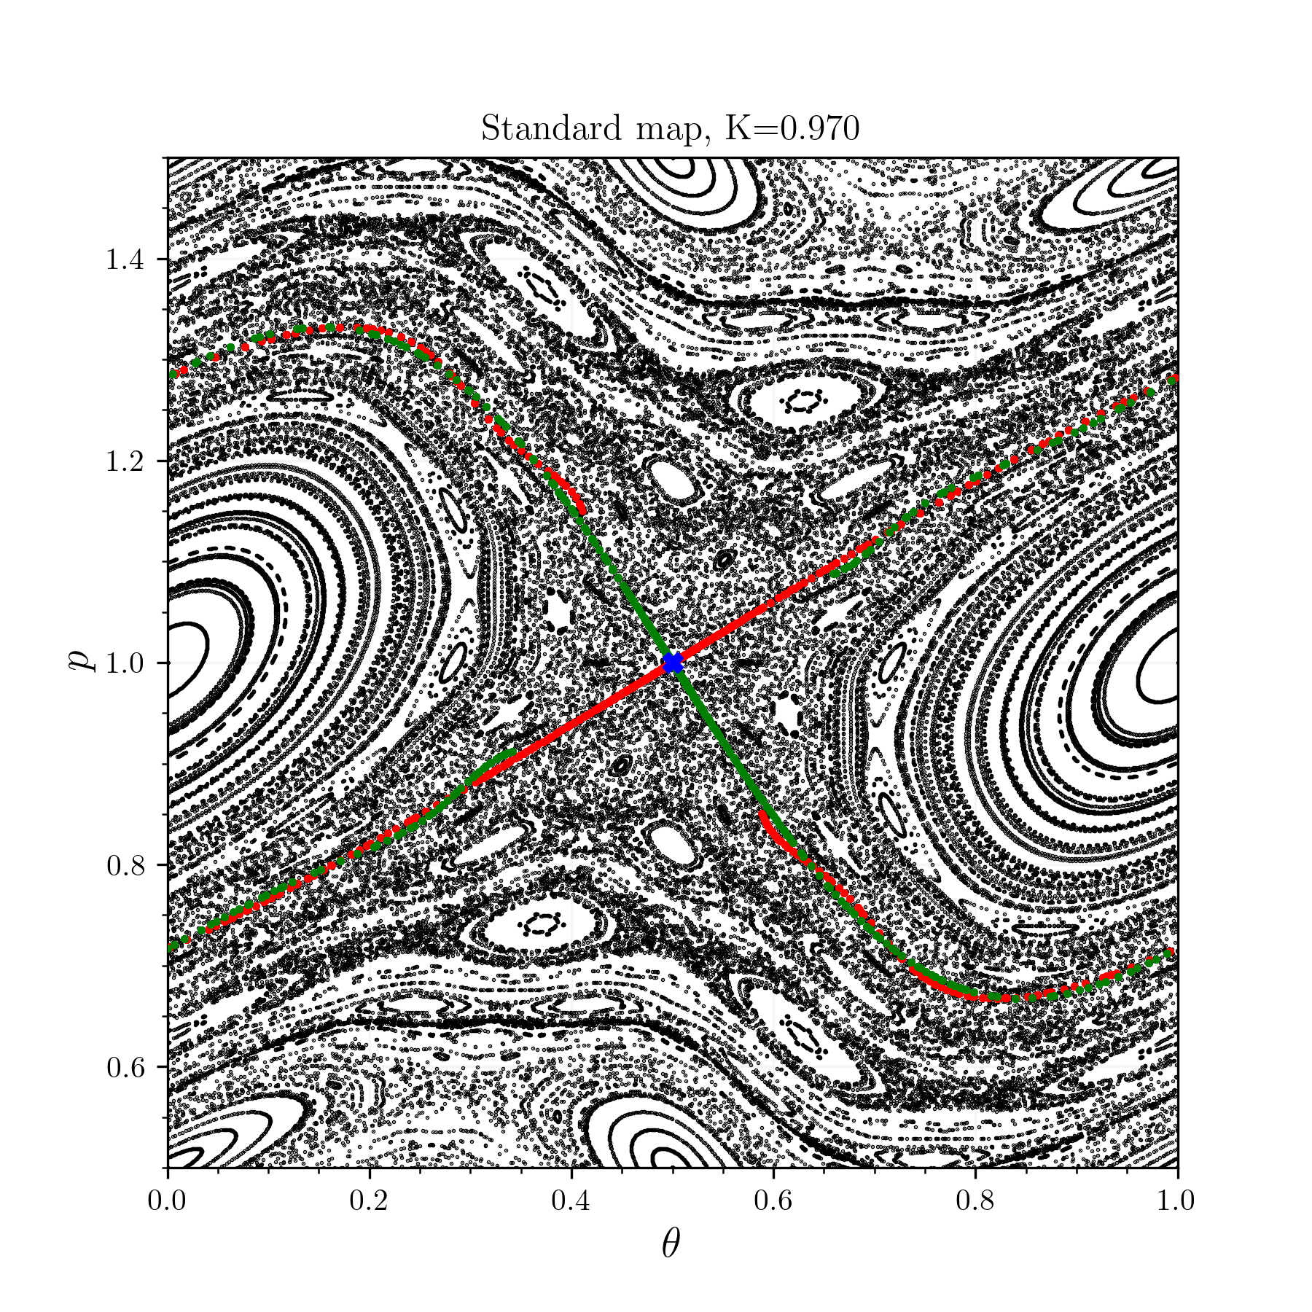
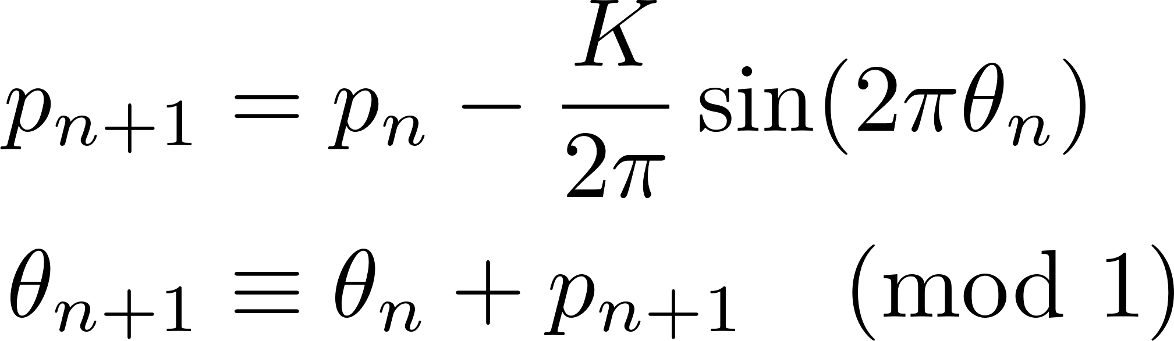
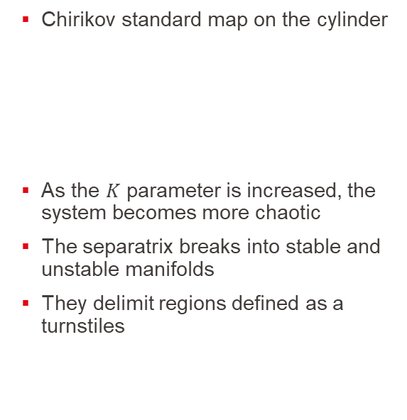
Separatrix of an island indicates Chaos by its brokeness
Chirikov standard map on the cylinder
As the $K$ parameter is increased, the system becomes more chaotic
The separatrix breaks into stable and unstable manifolds
They delimit regions defined as a turnstiles
Meiss, ‘Thirty Years of Turnstiles and Transport’.

Slide 8
Turnstile area - leaving and entering points
A point starting inside the intersection of the two manifold then leaves the bounding region still being in the
The standard map preserves the area form
The poincare map preserves the flux form
A turnstile
So how to compute this turnstile flux

Slide 9
Introducing a Toybox, Principles

Slide 10
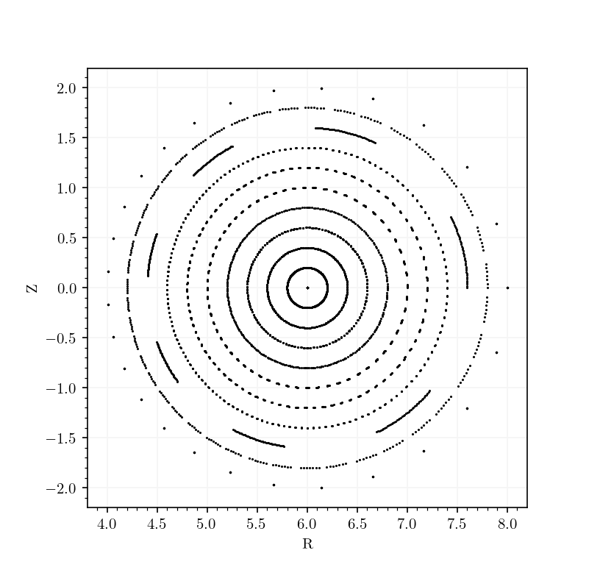
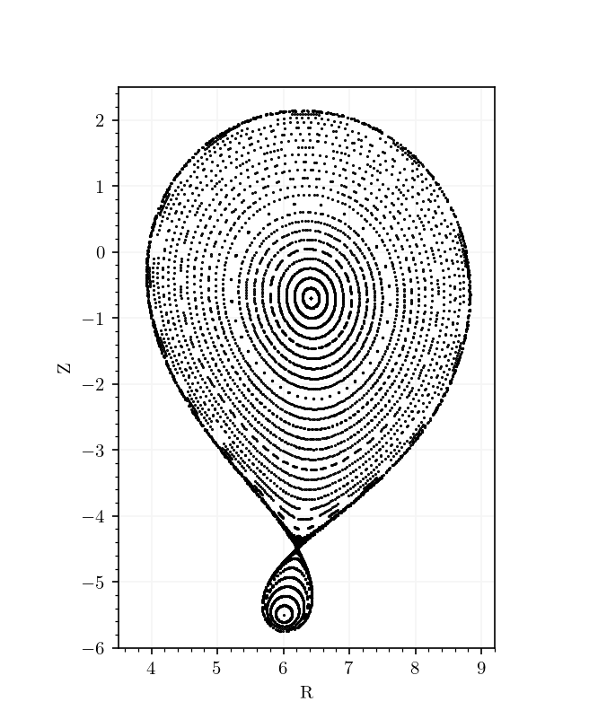
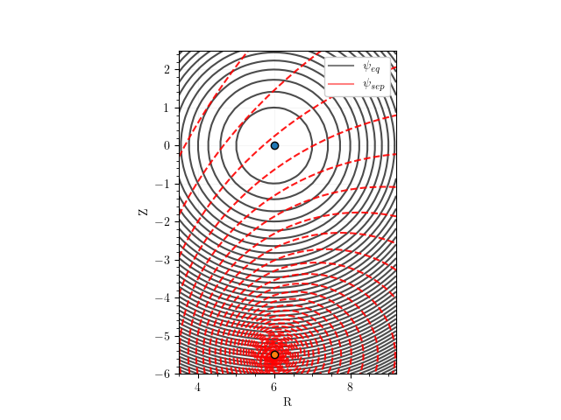
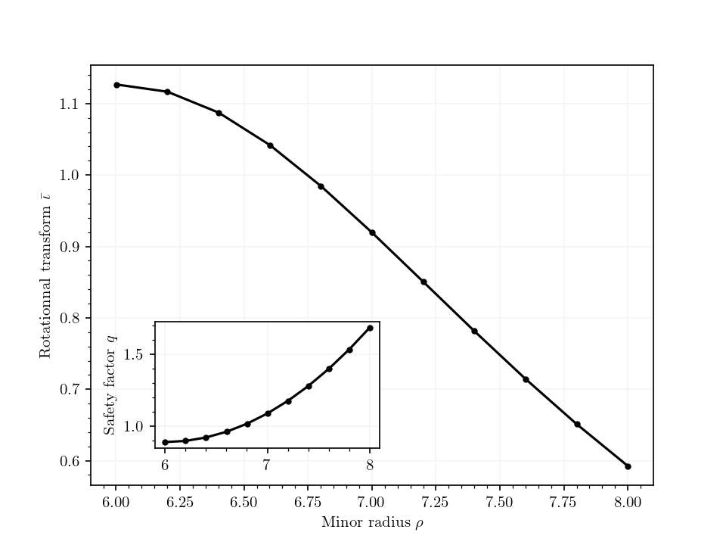
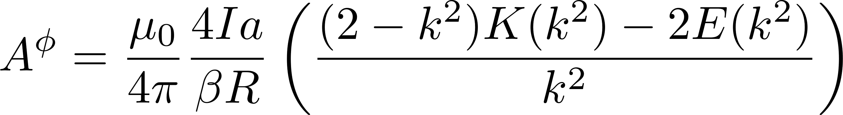
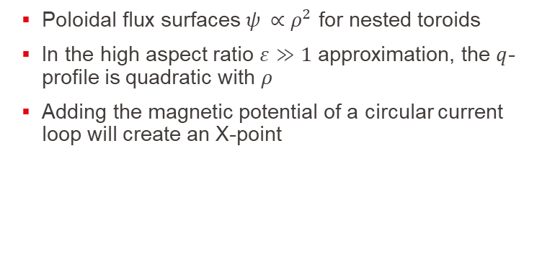
Toybox, Toy Tokamak equilibrium
Poloidal flux surfaces $ψ_{ }∝ρ^{2}$ for nested toroids
In the high aspect ratio $ε≫1$ approximation, the $q$-profile is quadratic with $ρ$
Adding the magnetic potential of a circular current loop will create an X-point
[Simpson et al., ‘Simple Analytic Expressions for the Magnetic Field of a Circular Current Loop’]

Slide 11
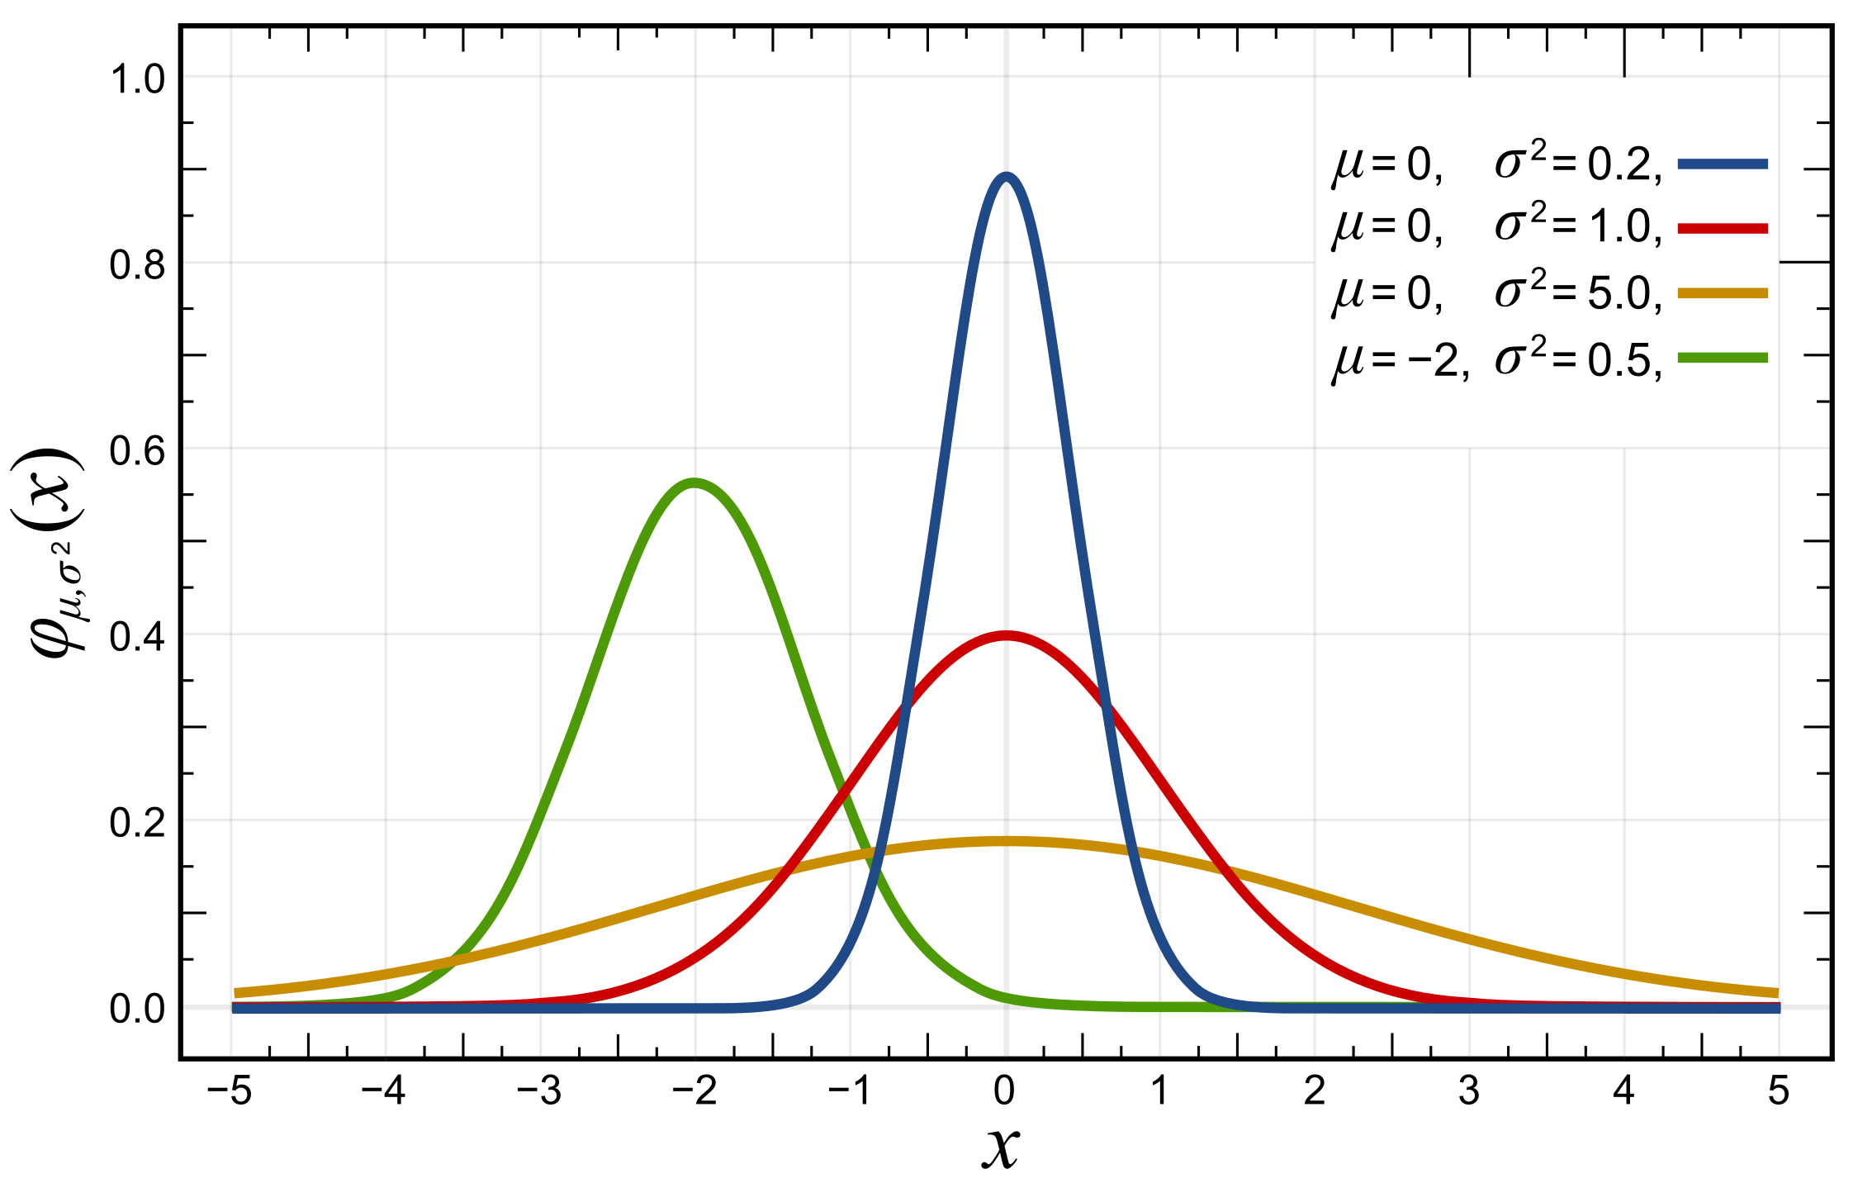
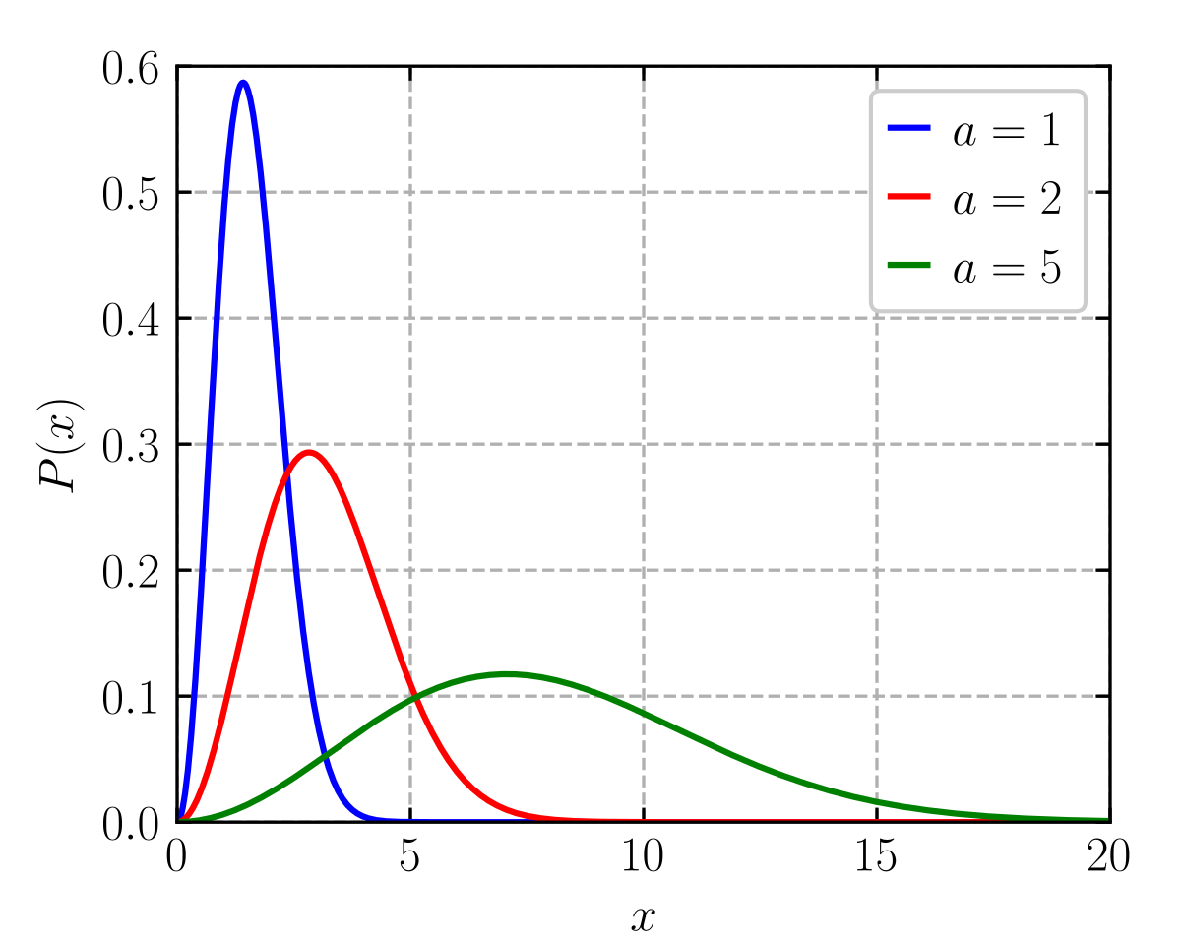
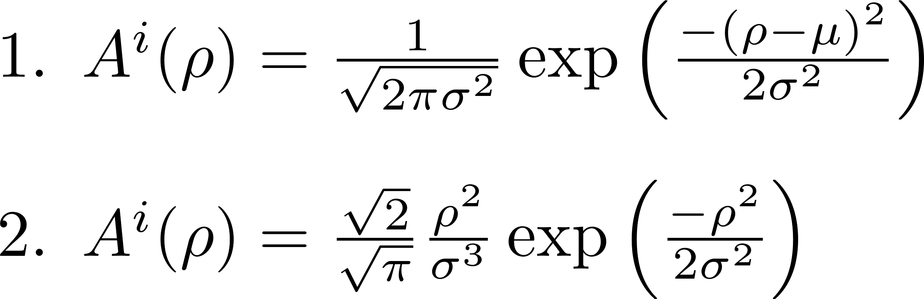
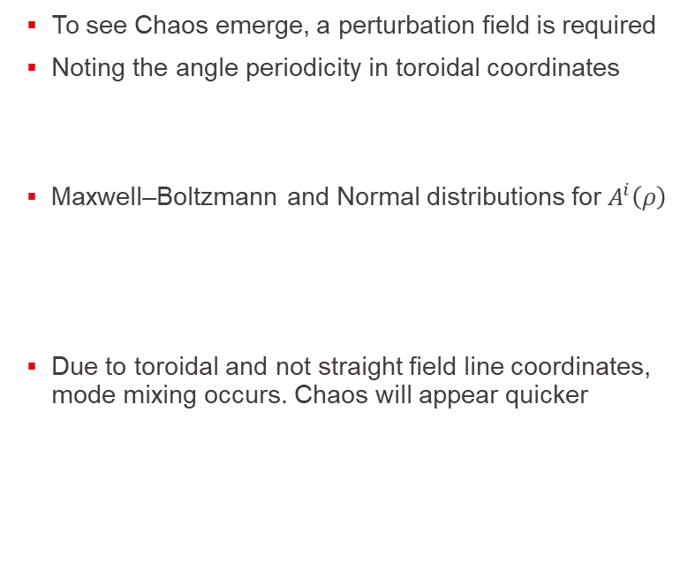
Perturbations
To see Chaos emerge, a perturbation field is required
Noting the angle periodicity in toroidal coordinates
Maxwell–Boltzmann and Normal distributions for $A^{i}\left(ρ\right)$
Due to toroidal and not straight field line coordinates, mode mixing occurs. Chaos will appear quicker

Slide 12
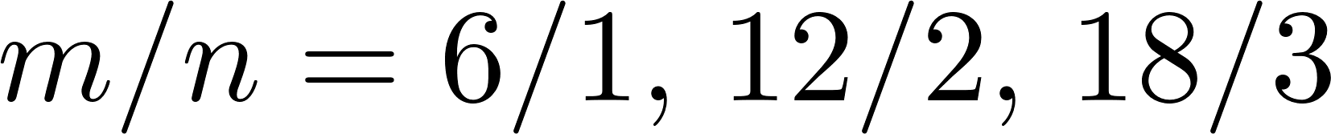
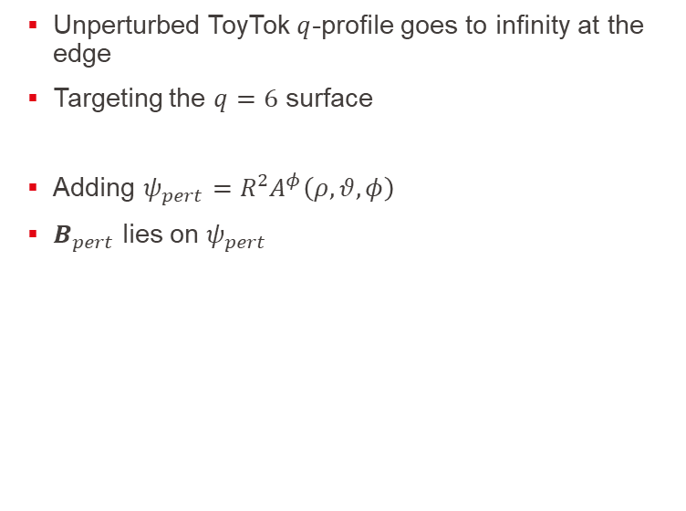
The Toytok - perturbed
Unperturbed ToyTok $q$-profile goes to infinity at the edge
Targeting the $q=6$ surface
Adding $ψ_{pert}=R^{2}A^{φ}\left(ρ,θ,φ\right)$
$B_{pert}$ lies on $ψ_{pert}$

Slide 13
Stable and unstable manifolds
Alpha beta limits set but more the points that goes as inf
The ordering
The concept of fundamental segments

Slide 14
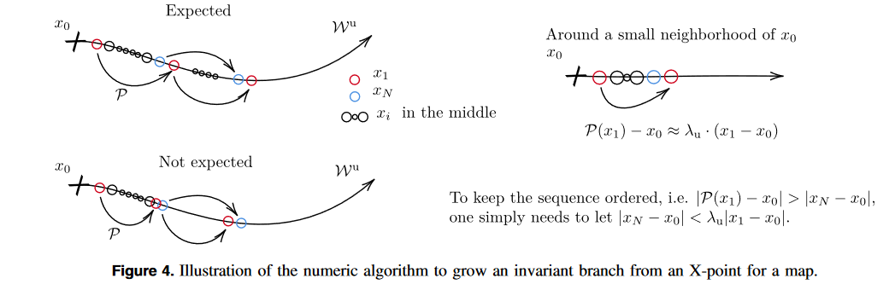
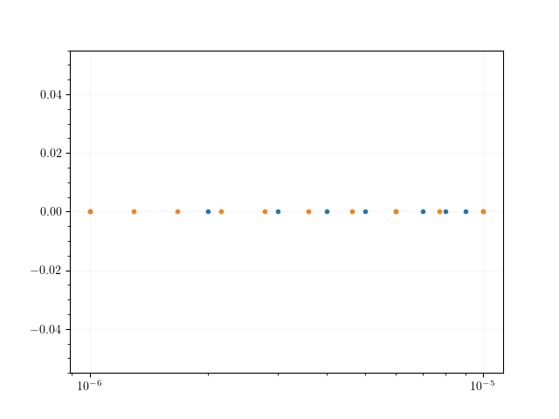
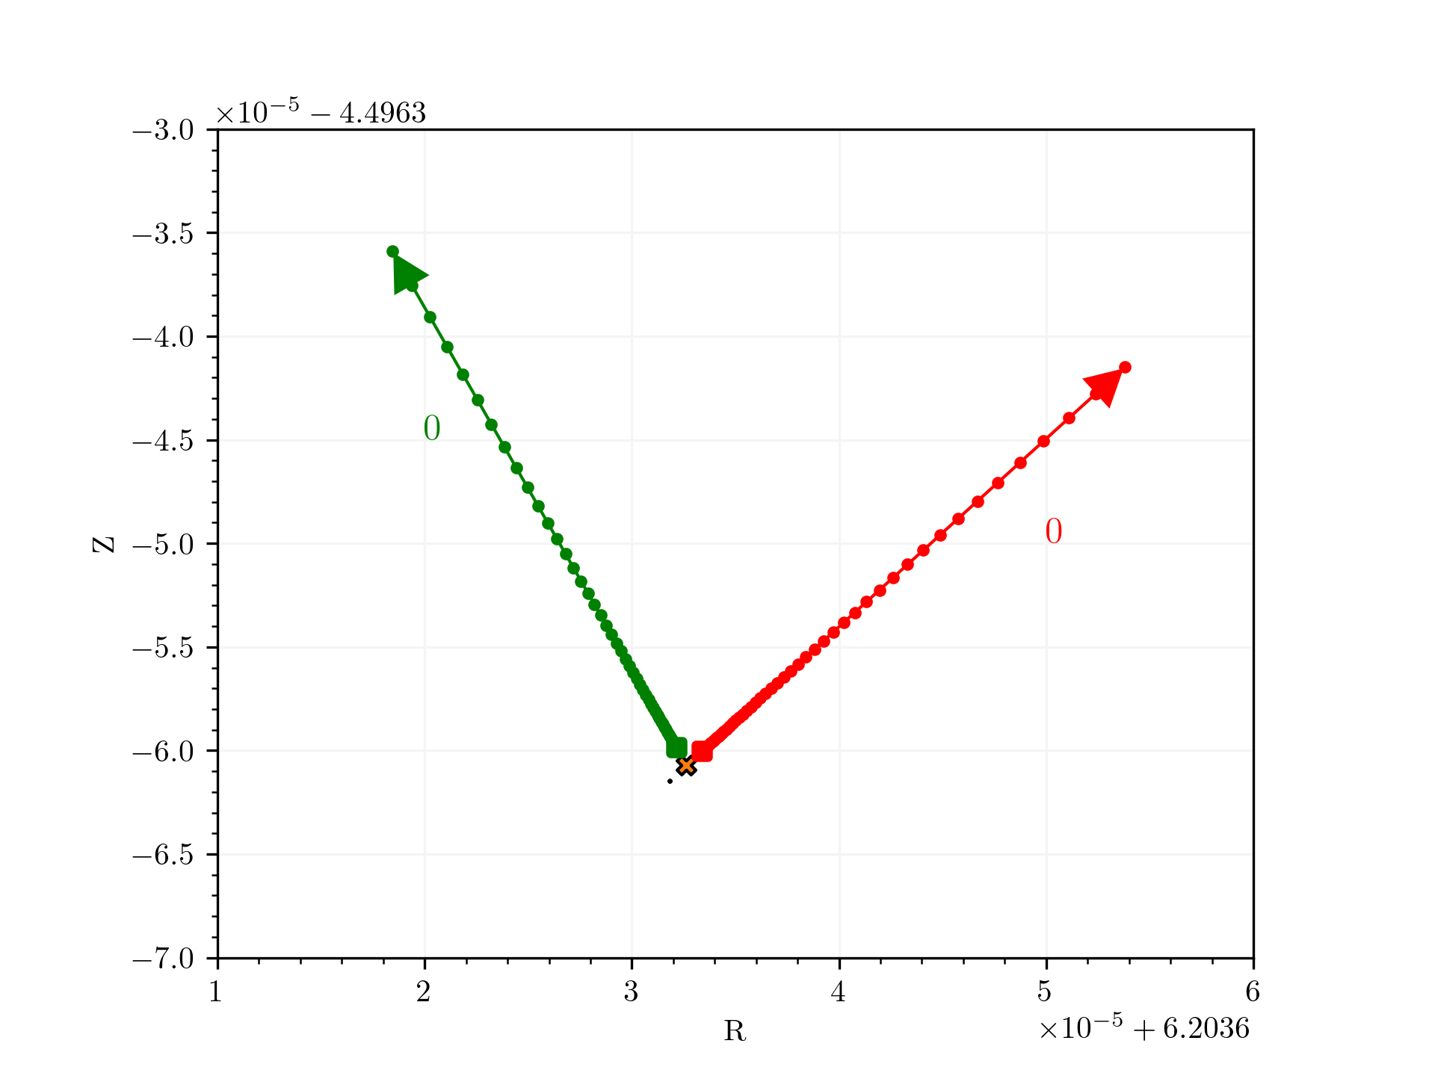
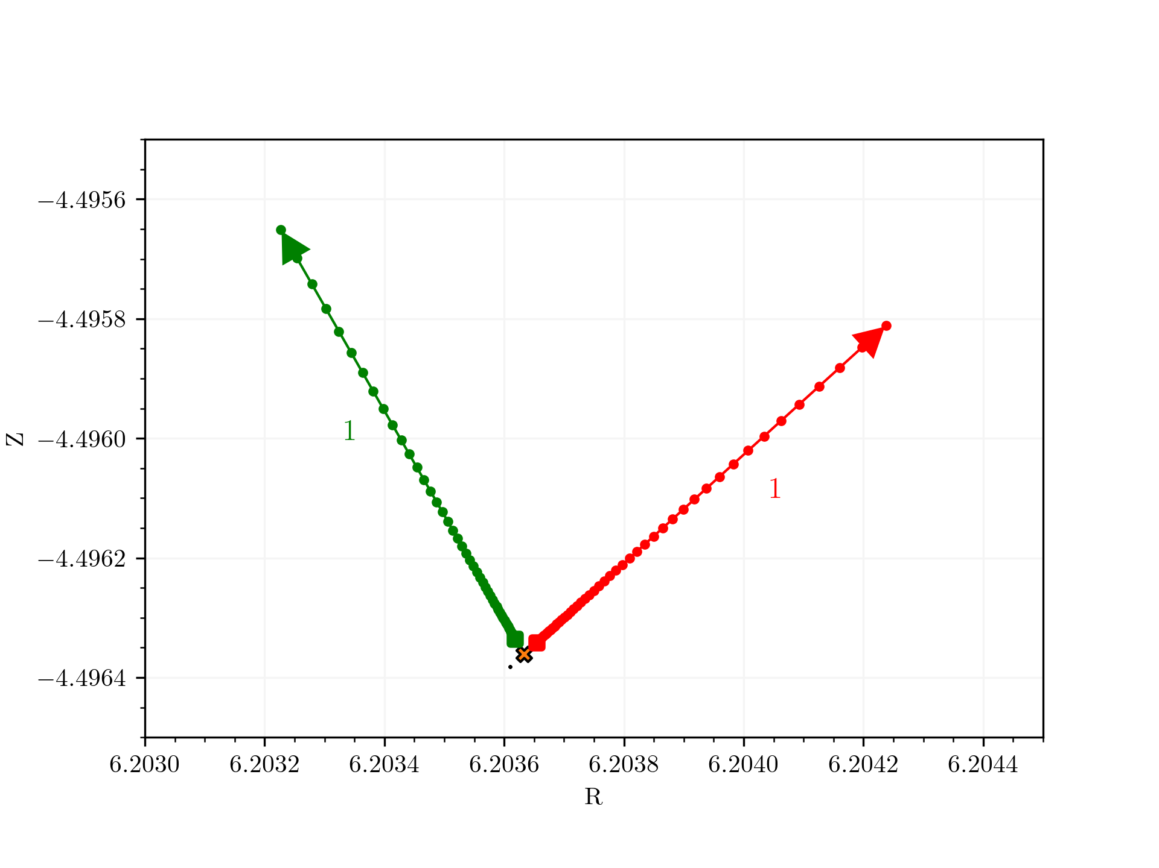
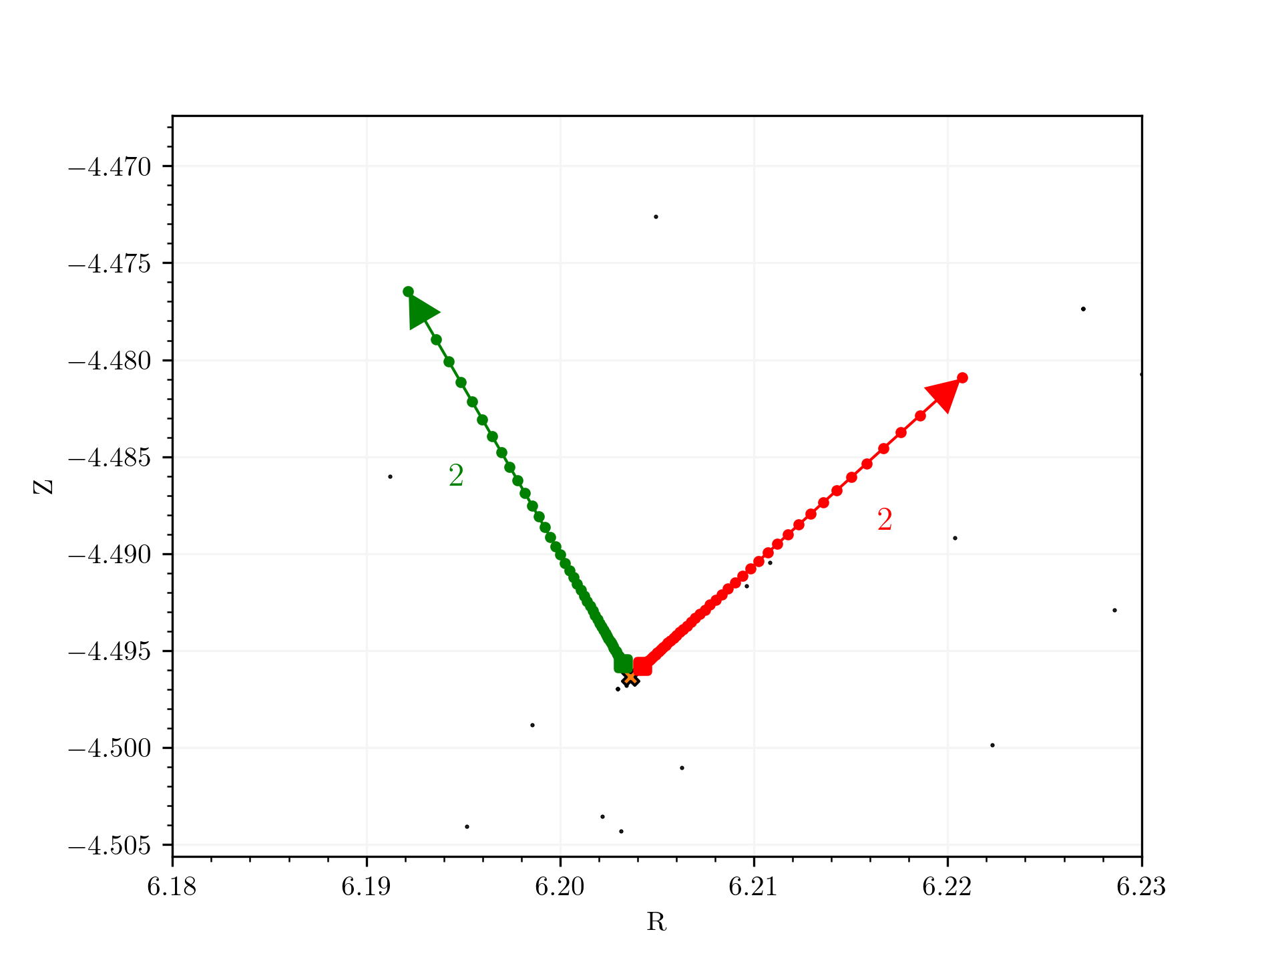
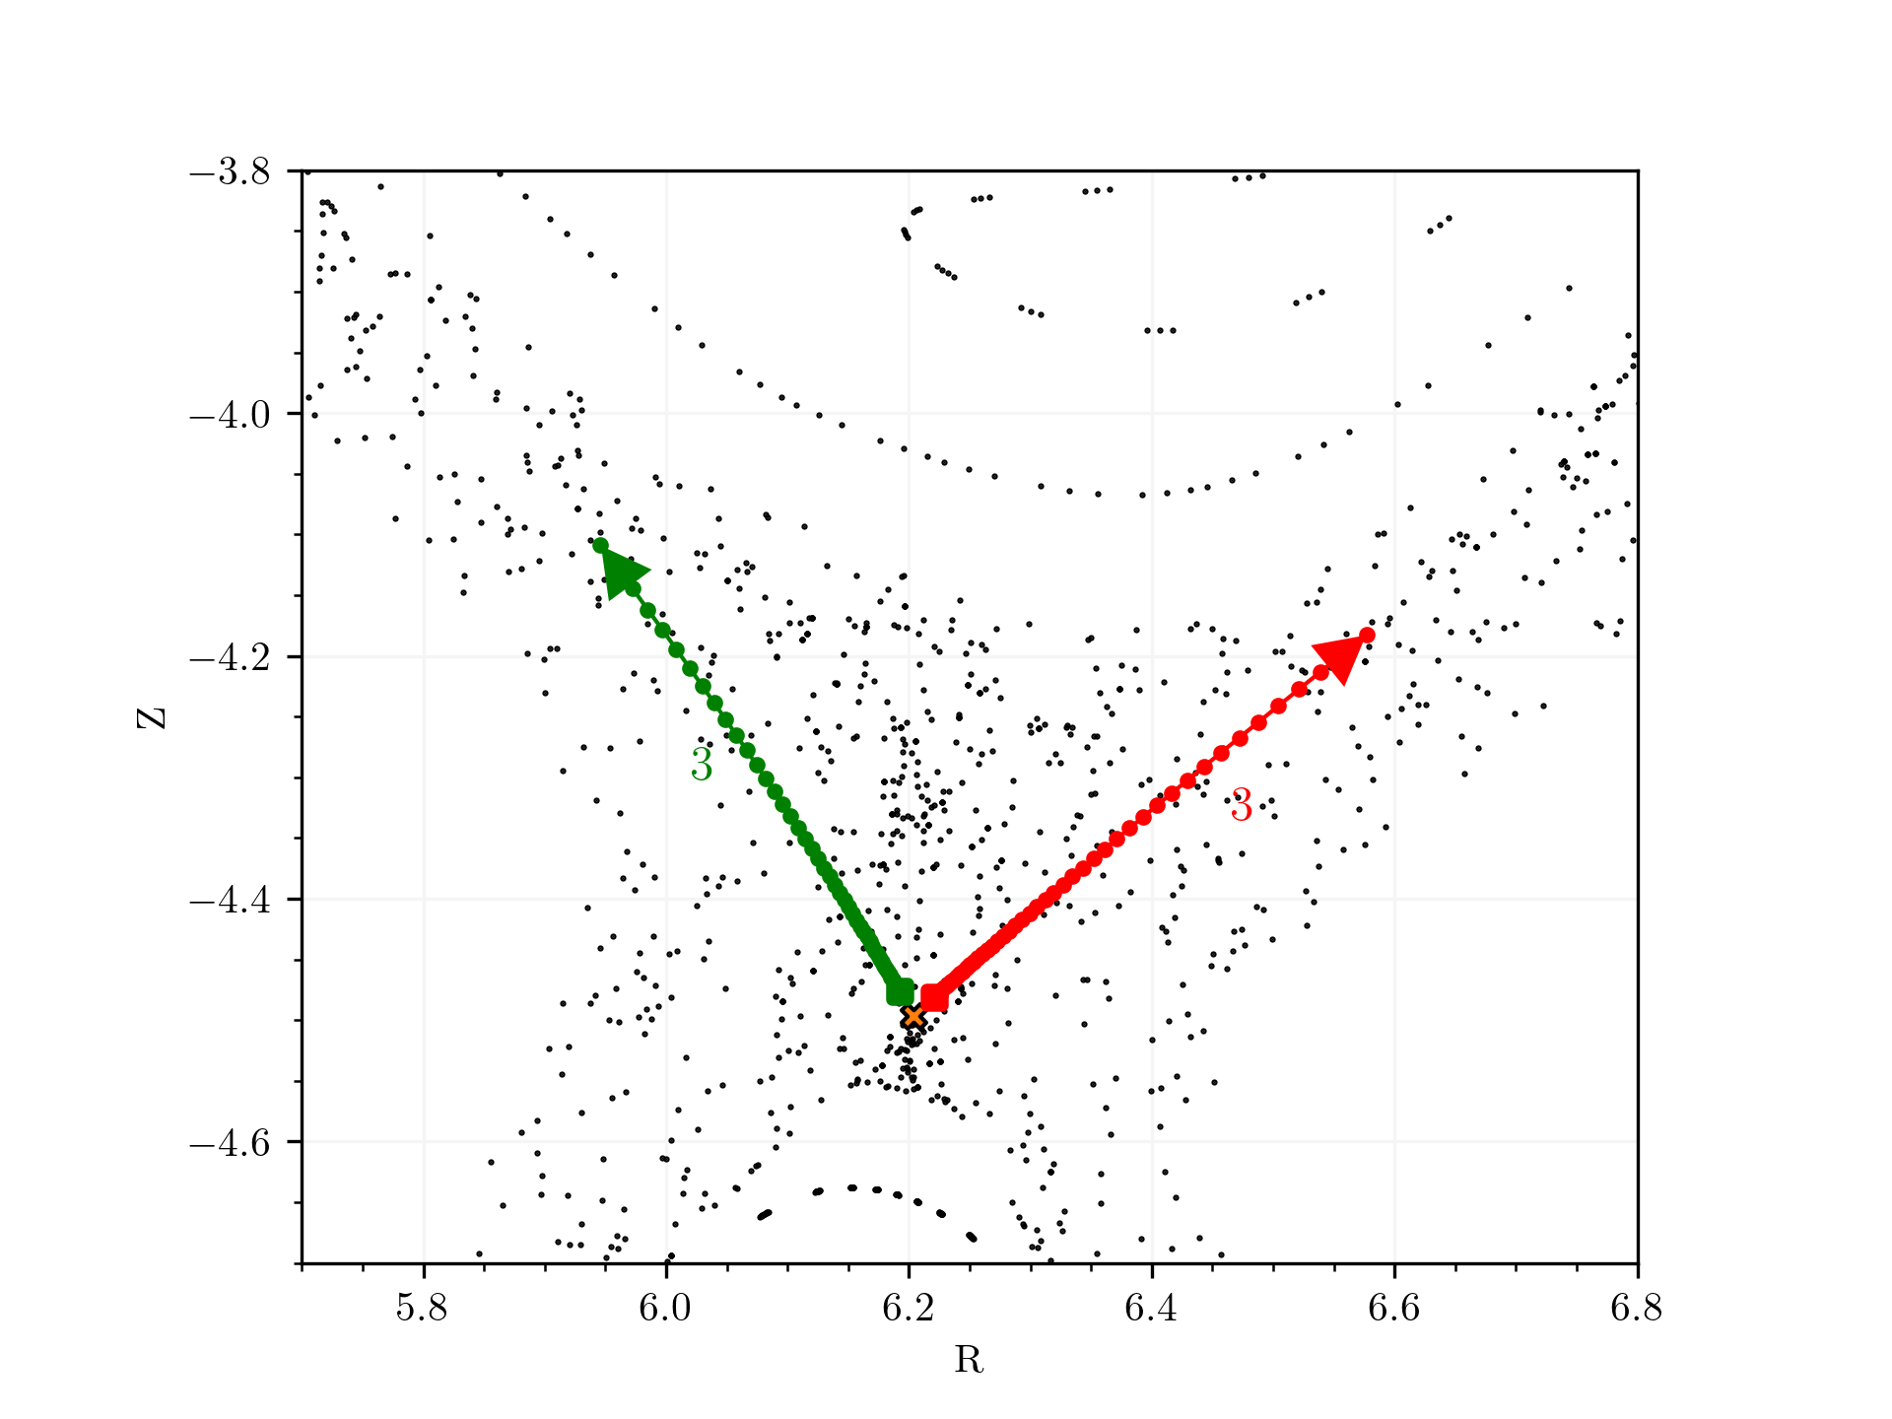
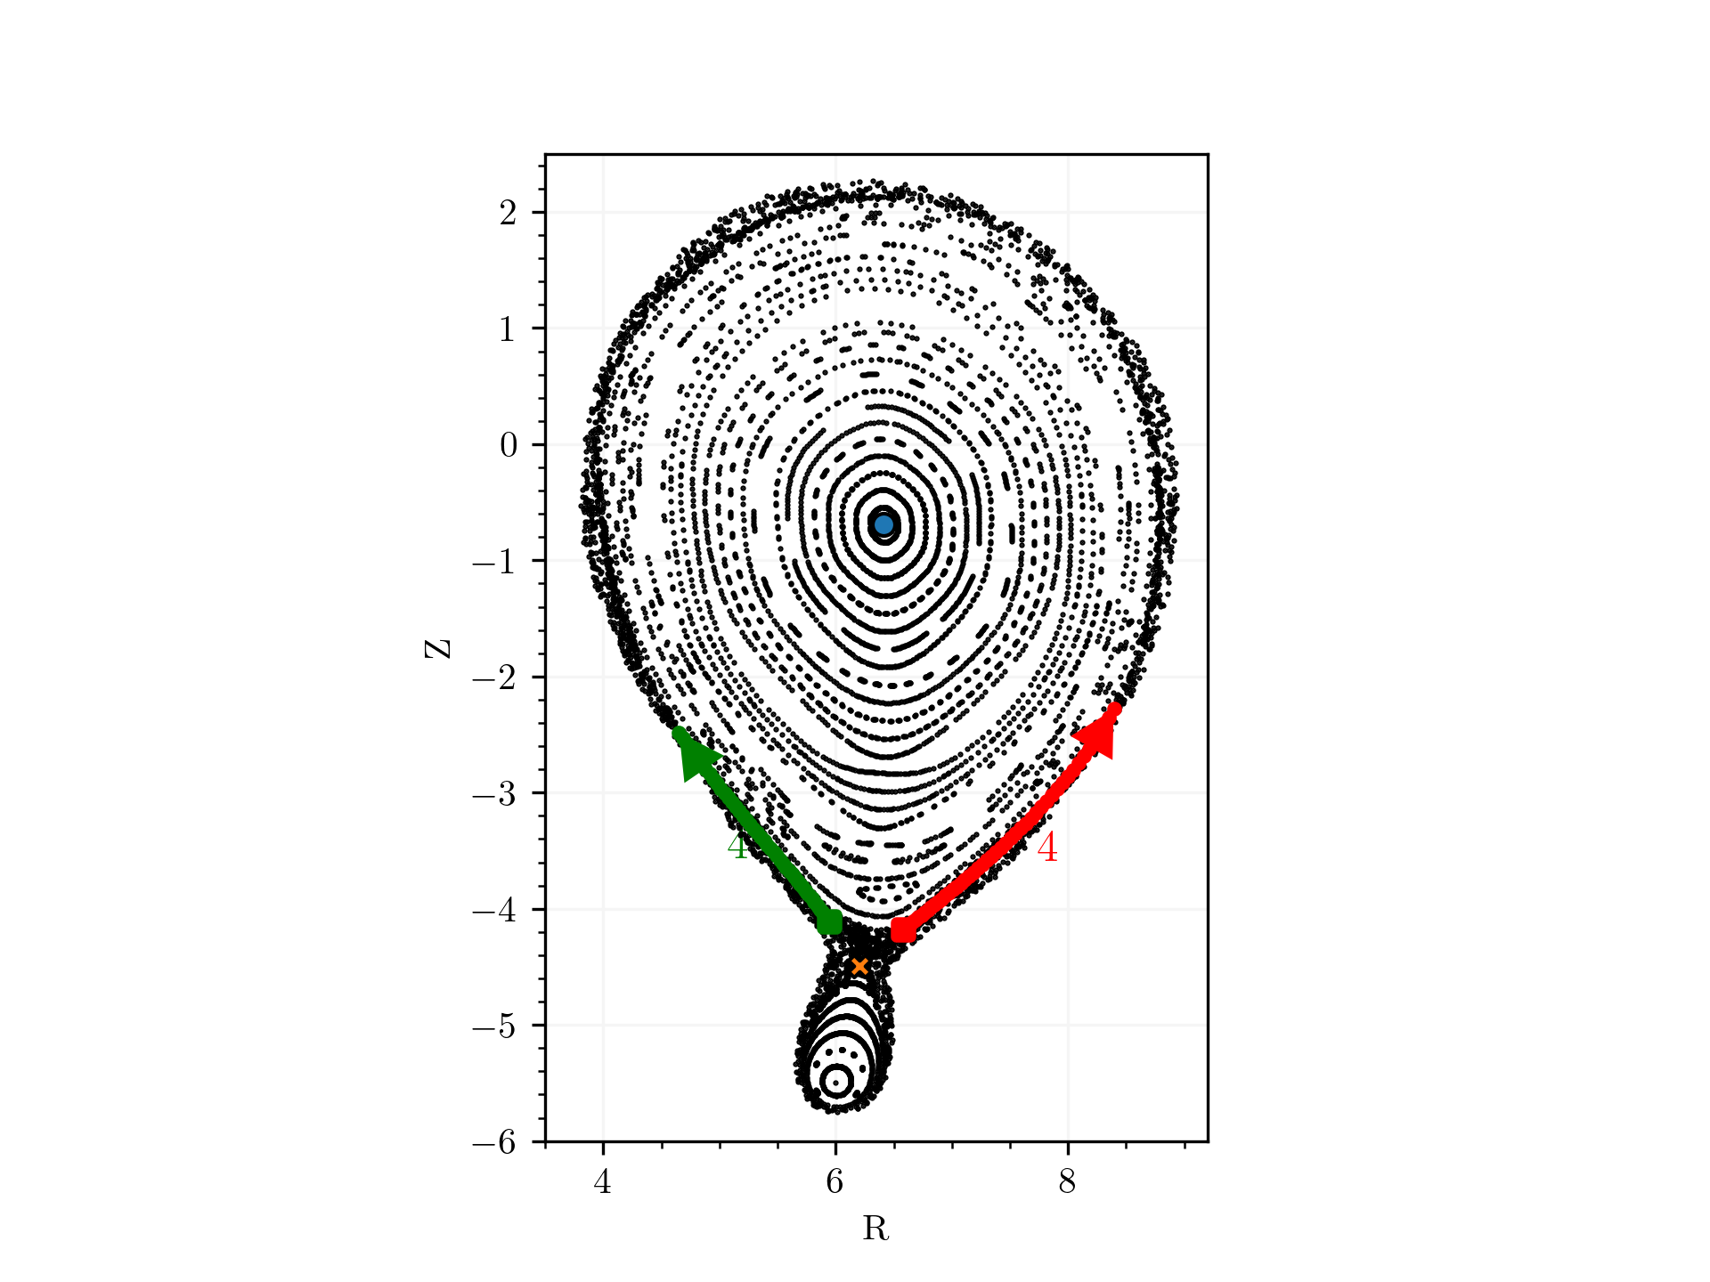
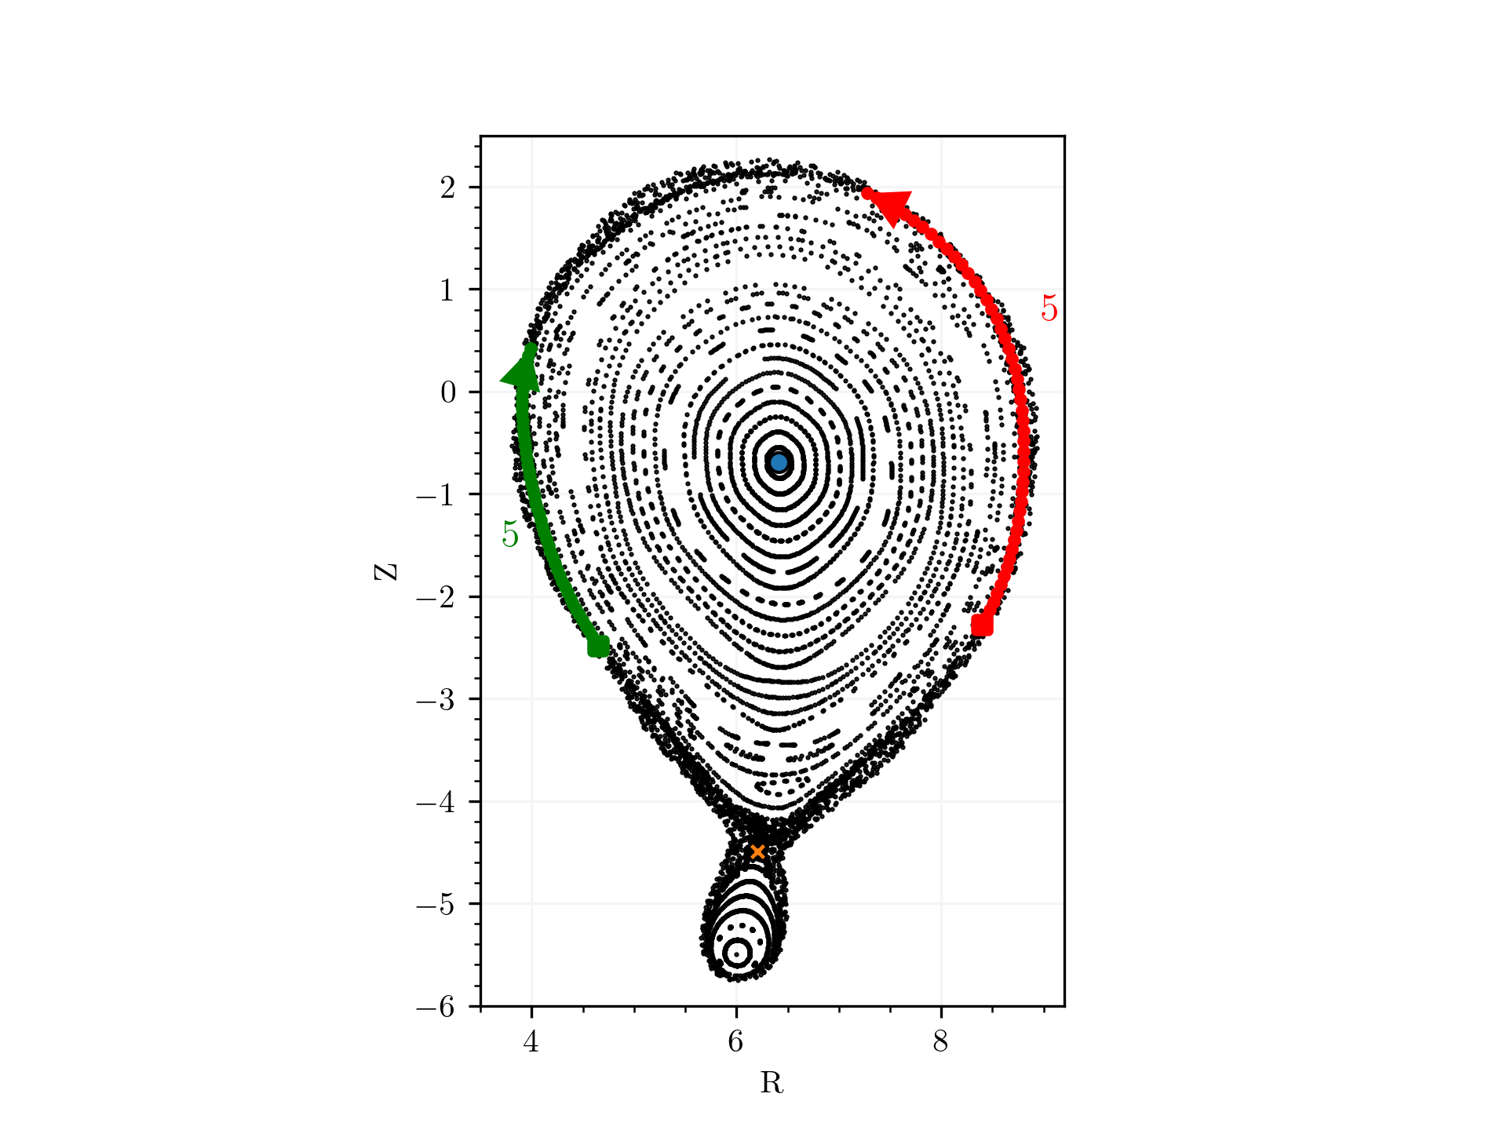
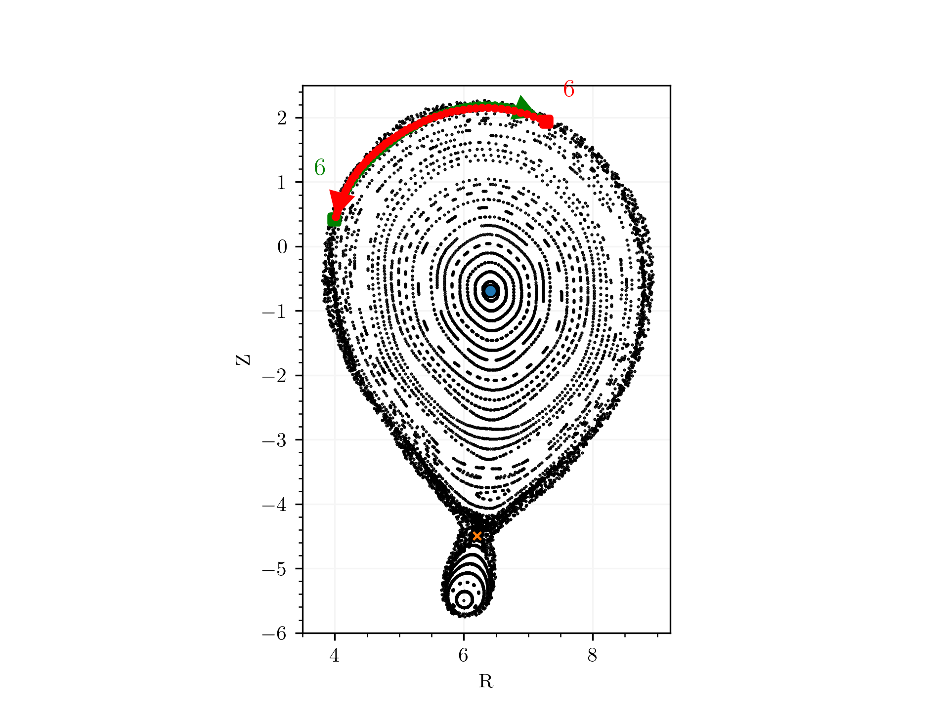
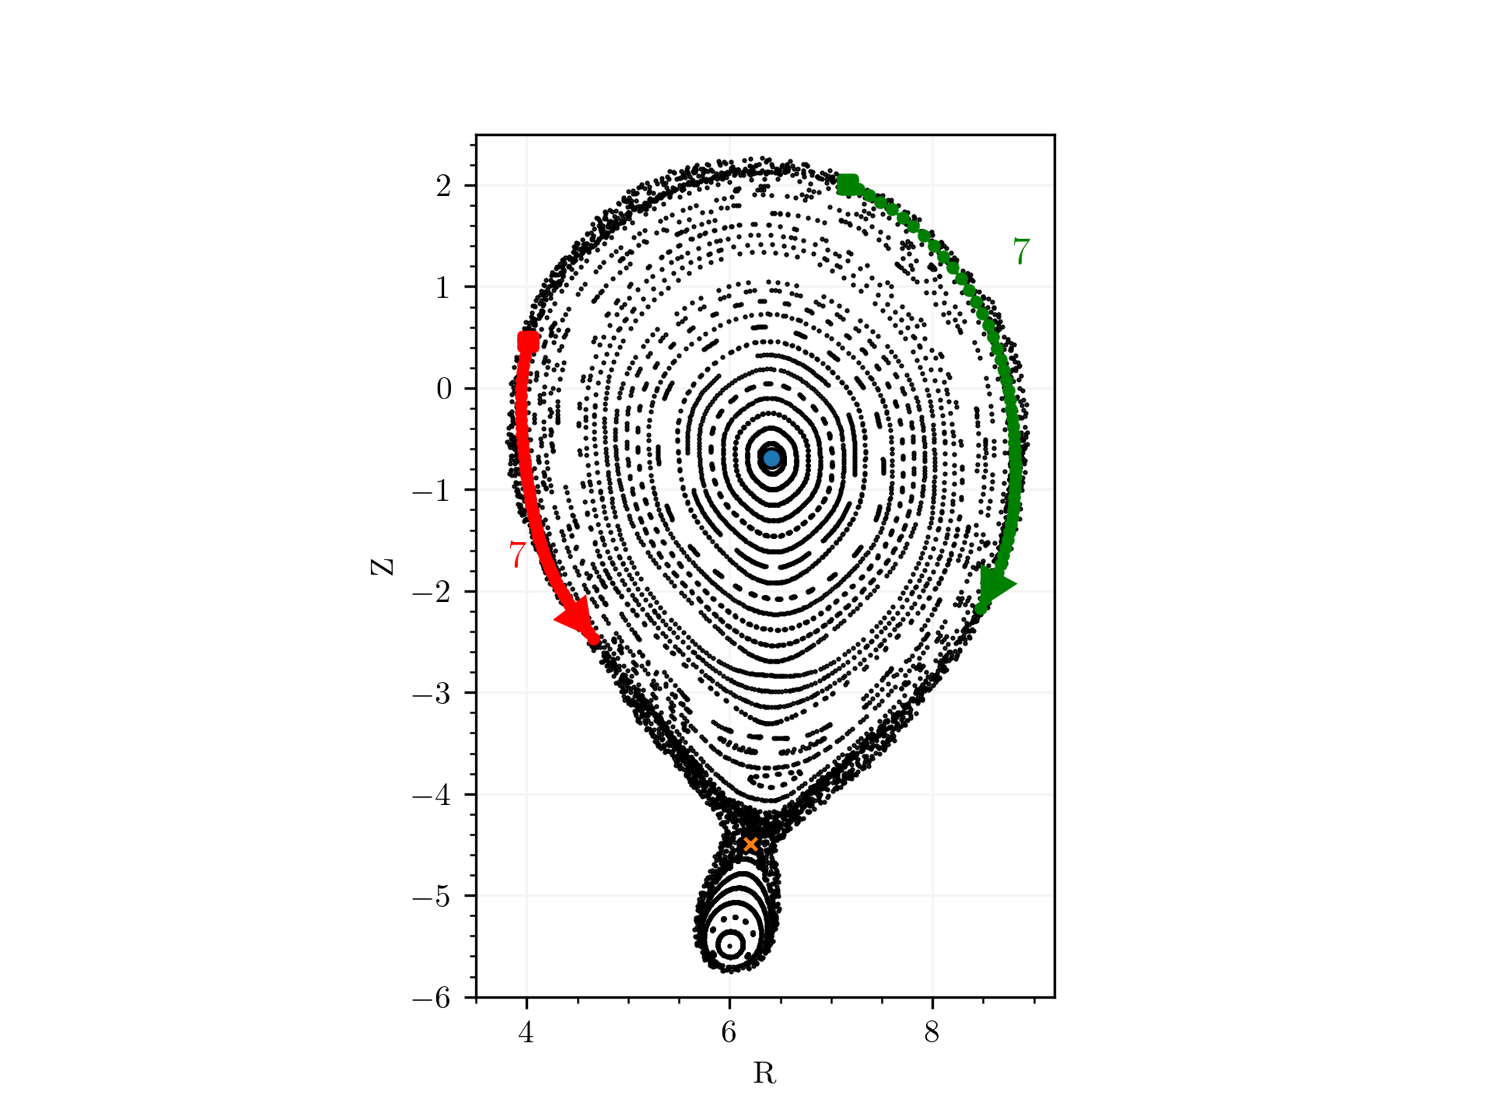
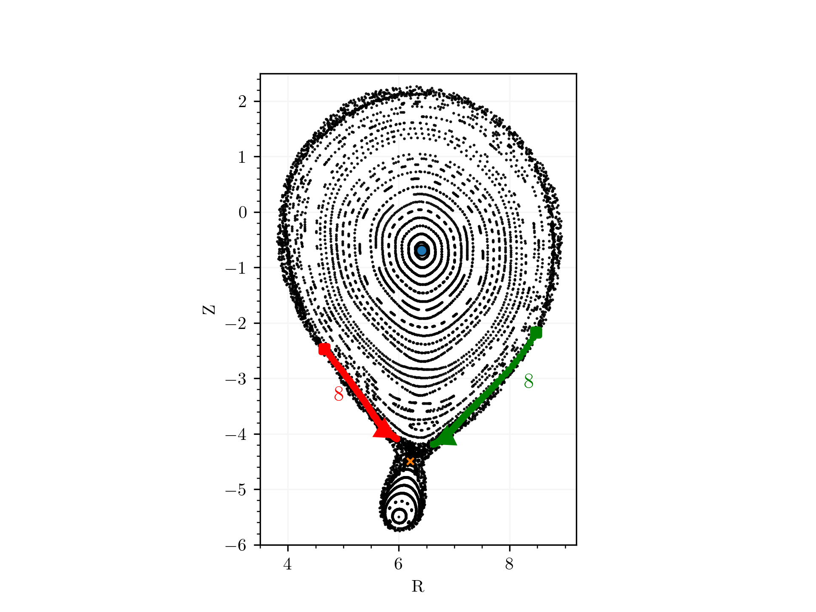
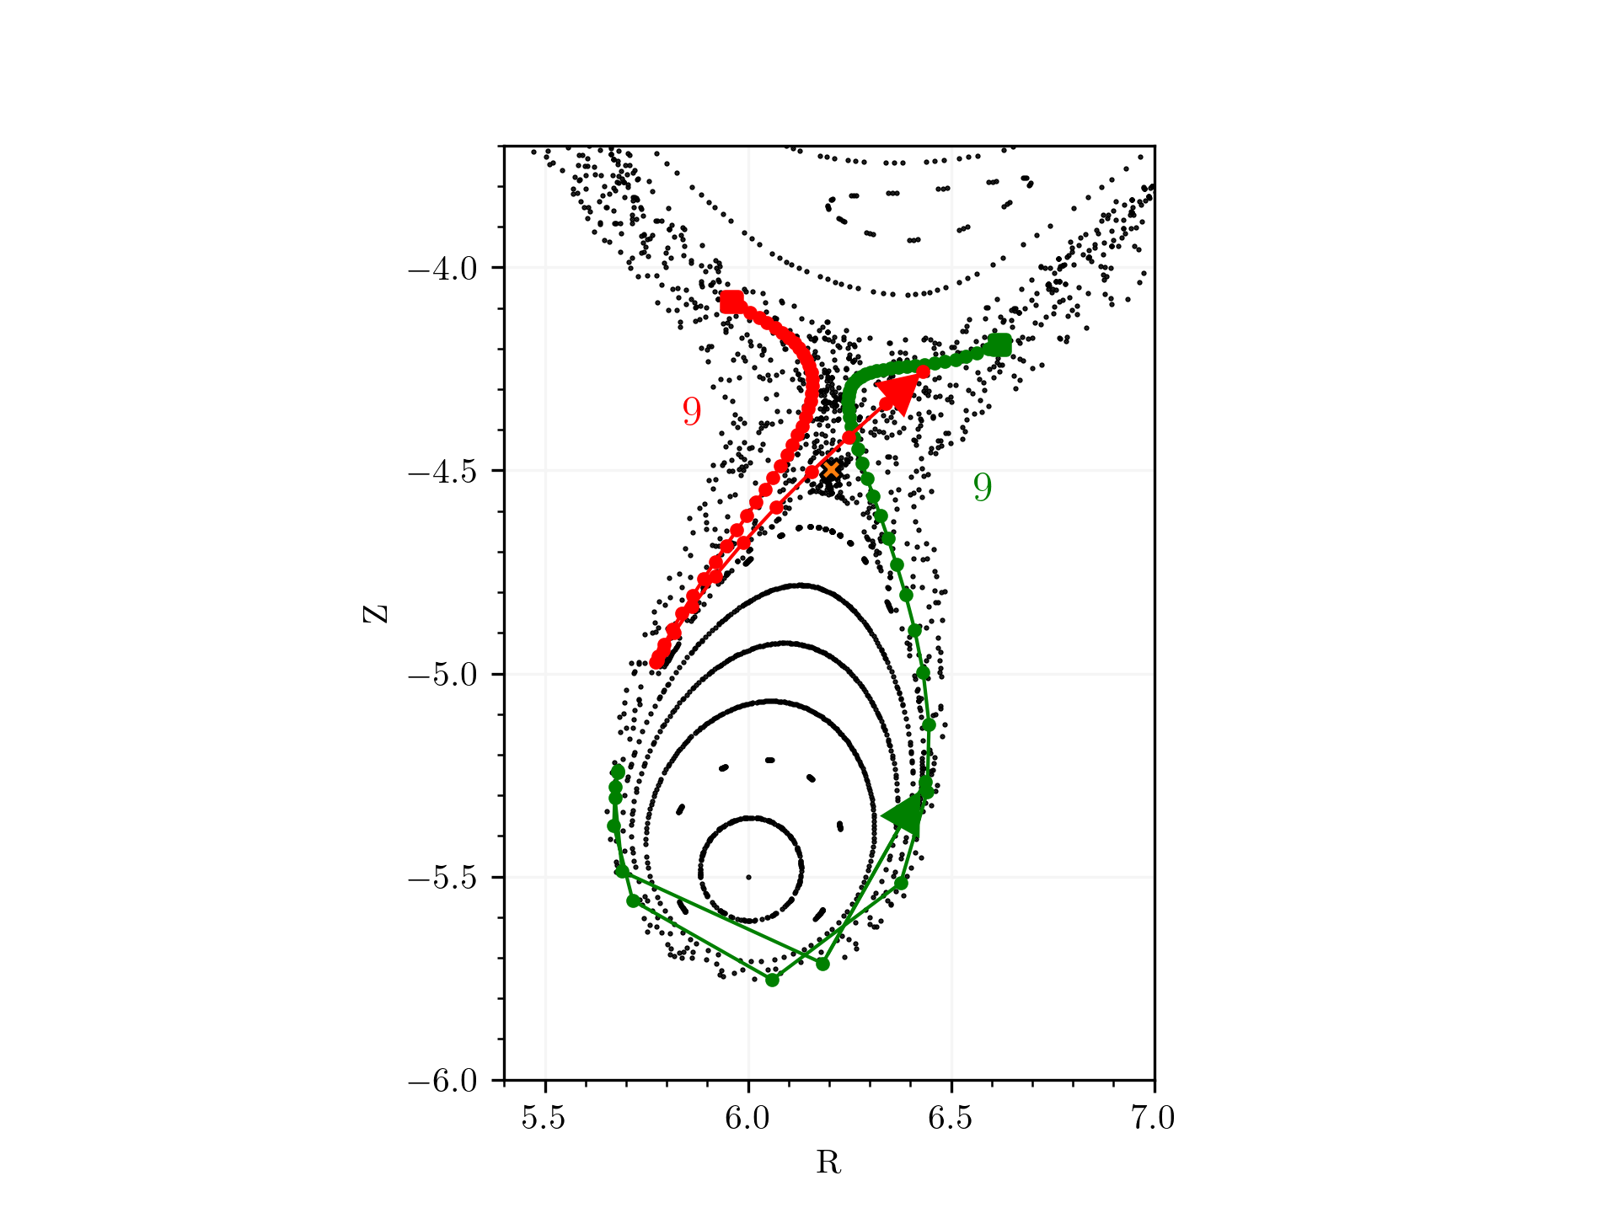
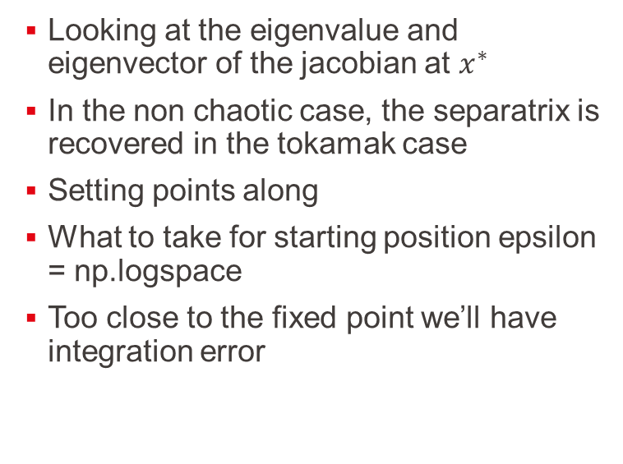
Finding the manifolds
Looking at the eigenvalue and eigenvector of the jacobian at $x^{∗}$
In the non chaotic case, the separatrix is recovered in the tokamak case
Setting points along
What to take for starting position epsilon = np.logspace
Too close to the fixed point we’ll have integration error
Notes:
The closer you are to the fixed point the , why exactly we have this behaviour change and we need even spacing in exponential space

Slide 15
Finding them in W7X
Against the connection length plot
What do we see ?

Slide 16
Meiss’ action principle for the standard map
The homoclinic points are the intersections
The formula is .. and works for an exact map
Is the poincare an exact map ? Supposed

Slide 17
Homo/Hetero-clinic points - Algorithm to find them
Given the
Intersection

Slide 18
W7X

Slide 19
Calculating the turnstile area in the case of the magnetic flow
Sigma surface
Adaptation
Two ways of calculating it
The Lengths goes to 0
Why not directly just one ? For high m it will take a lot of time ?

Slide 20
Toytok - Verification
Calculation of the area with the shoelace formula
Obtained value
Convergence plot

Slide 21
Calculation of the turnstile area for W7X-GYM00-1750
Turnstile area

Slide 22
Stellarator optimization
Simsopt and reducing/increasing chaos of certain islands

Slide 23
LHD
Simsopt and reducing/increasing chaos of certain islands

Slide 24
Quasr configurations
Simsopt and reducing/increasing chaos of certain islands

Slide 25
Wrapping things up
Notes:
Not complicated algorithms overall but a combination of things that need to be used.

Slide 26
Action principle in detail for exact maps
Symp
What is an exact map :

Slide 27
Flux form and the flux conservation

Slide 28
Link between the flow map determinant and the divergence free field

Slide 29
Standard Map

Slide 30
Symplectic maps
Symp
What is an exact map :

Slide 31
Floer Homology
Nice papers !

Slide 32
Alternating hyperbolic fixed points

